Slide 1
Draw an image that represents what you think the following title might mean…
Do It Now…
‘Slow writing’
Individual work
Notes:
Share ideas and discuss what it could mean.

Slide 2
L.O. To create an effective piece of 'slow writing'
What does this image make you think of?
Do you prefer to read in your head, out loud, or listen to someone else reading?
Notes:
Build the excitement when you tell the students that they will have the opportunity to create an audiobook story that they have written… Depending on school/equipment etc. If not, discuss the ideas around stories being one of the oldest art forms and different ways we take in information about events.

Slide 3
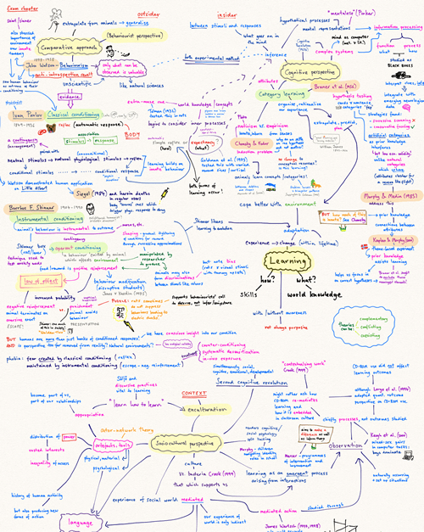
Brain splurge
How do you plan?
Why should you plan?
Key concerns?
Notes:
Explain that this is what the students are going to do on the following images/posters in groups of 4

Slide 4
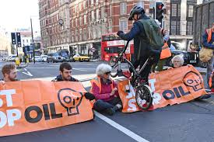
Descriptive Plan – consider senses, setting, atmosphere, feelings
3 minutes
Notes:
Stop Oil Conflict
3minutes
Some of these images may create discussions

Slide 5
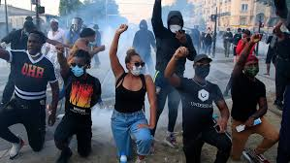
Descriptive Plan – consider senses, setting, atmosphere and feelings
3 minutes
Notes:
Black Lives Matter Conflict
3minutes

Slide 6
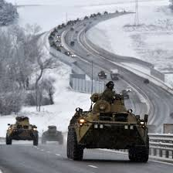
Descriptive Plan – consider senses, setting, atmosphere and feelings
3 minutes
Notes:
Russia/Ukraine Conflict
3minutes

Slide 7
Descriptive Plan – consider senses, setting, atmosphere and feelings
3 minutes
Notes:
Yemen conflict
3minutes

Slide 8
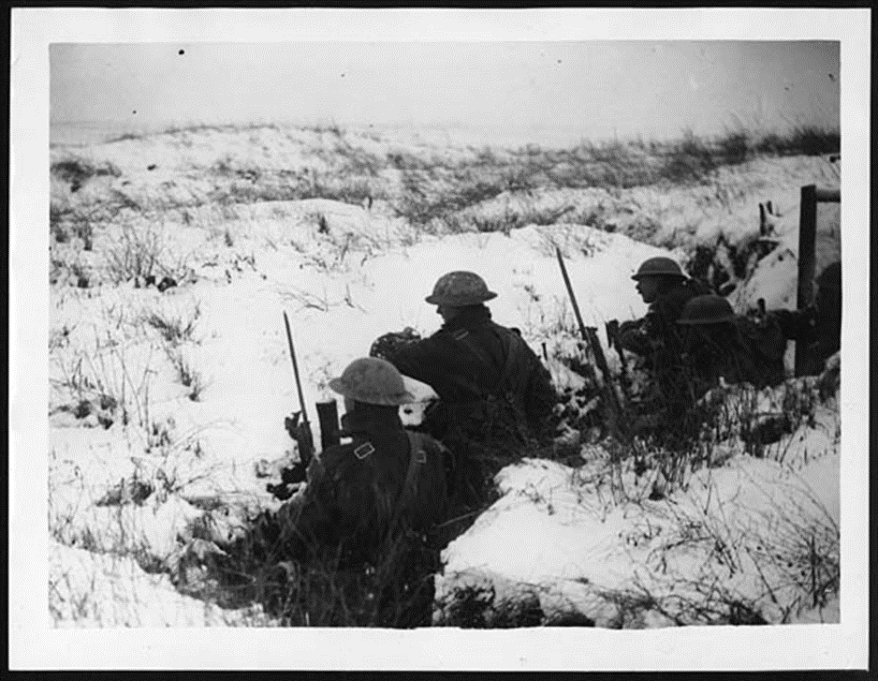
Write a descriptive paragraph using this image as your starting point
Notes:
Plan vocabulary initially for 1 min – can do this individually.
Write a descriptive paragraph – 3 minutes

Slide 9
Choose your favourite…
Biting wind devoured every piece of flesh visible, regardless of enemy lines. Fingers turned blue as they poised on the trigger of the heavy rifles; eyes constantly surveying the frozen landscape of no-man’s land, blinded by the vast nothingness and snow-covered mounds – bodies or earth, no one knew any more.
Each soldier longed for the warm comfort of home and easy conversation…
The icy snow made the soldiers freezing and wish they were at home. Their fingers were turning blue and they shivered in the biting wind. They slowly aimed their gun towards the enemy line and held their fire. They missed the comfort and warmth of their home every day, but they knew this wouldn’t last much longer. They were told it would be over by Christmas.

Slide 10
Start your sentence with the phrase
'when the soldier …’
Start your sentence with the word 'when'.
EXTRA CHALLENGE:
Can you use ambitious vocabulary in your writing?

Slide 11
Your next sentence will have a simile in it.
Your sentence will use alliteration.
EXTRA CHALLENGE:
Can you use different devices together create overall effect?

Slide 12
Your sentence will start with an adverbial (word ending with -ly).
Your sentence will start with a present participle (word ending with -ing).
EXTRA CHALLENGE:
Can you use ambitious vocabulary and effective punctuation in your writing?

Slide 13
Your sentence will have 3 words.
Your sentence will have 3 words – alliteration/assonance
EXTRA CHALLENGE:
Can you use ambitious vocabulary in your writing?

Slide 14
Your sentence will start with 'despite'.
Your sentence will contain exactly 23 words and use a semi colon.
Your sentence will contain exactly 23 words and use a semi colon for effect, as well as ambitious vocabulary.

Slide 15
Your sentence will start with one of these subordinating connectives, and then use a comma after the first clause.
Subordinating Connectives
If
When
While
Since
As
Though
Your sentence will use a colon.
Your sentence will use a colon, but NOT to introduce a list, or a semi colon

Slide 16
Your sentence will include a sub-ordinate clause
Example: In the silently falling snow, the soldier struggled to see the shards of flying shrapnel.
Now try moving the subordinate clause
Next try splitting the main clause
EXTRA CHALLENGE:
Your sentence will have 3 clauses but it won't use the word 'and'.

Slide 17
Your sentence will use the word 'below'.
Your sentence will start with the word 'because'.
Your sentence will start with a subordinating connective.

Slide 18
Your sentence will contain exactly 10 words.
Your sentence will contain a metaphor or personification, use ambitious vocabulary and be 10 words long.
Your sentence will contain a simile.

Slide 19
Your sentence will start with the phrase 'As suddenly as...'.
You can write two sentences, but one sentence will be a holophrastic phrase (one-word sentence).
EXTRA CHALLENGE:
Can you use ambitious vocabulary and effective punctuation in your writing?

Slide 20
Use a circular narrative structure and finish your story in the same way/setting/repeat the opening at the end.

Slide 21
PROOF-READ!
Editing checklist:
Can you make your writing more engaging and vivid?
How gripping is your writing? Can you enhance this?
Can you develop your vocabulary choices to include sophisticated language?
Have you written in the same tense throughout?
Devices checklist:
Do all of your devices work? Are they shoe-horned in?
Can you develop any of the language devices?
Pathetic fallacy?
Sibilance?
Personification?
Checklist - SPaG:
Capital letters and full stops accurately
Apostrophes
Speech marks
Commas
Check the punctuation wheel
Correct and accurate spellings

