Slide 1
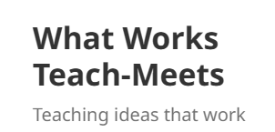
Subject pedagogy for mathematics: Collaborative learning, Mastery and Realistic Mathematics Education (RME)
Graham Griffiths, IOE UCL’s Faculty of Education and Society
Martin Newton, MEI (Mathematics in Education and Industry)
Davide Penazzi, University of Central Lancashire School of Engineering and Computing

Slide 2
What Works Teach Meets 2 Graham Griffiths Collaborative learning
IOE – FACULTY OF EDUCATION AND SOCIETY

Slide 3
Aims / outcomes
Aim
To consider key aspects of mathematics teaching practice and related literature
Learning outcomes
Identify what is meant by collaborative learning in mathematics
Explore at least two collaborative learning activities

Slide 4
Odd one out
Which of the following is the odd one out? Why?

Slide 5
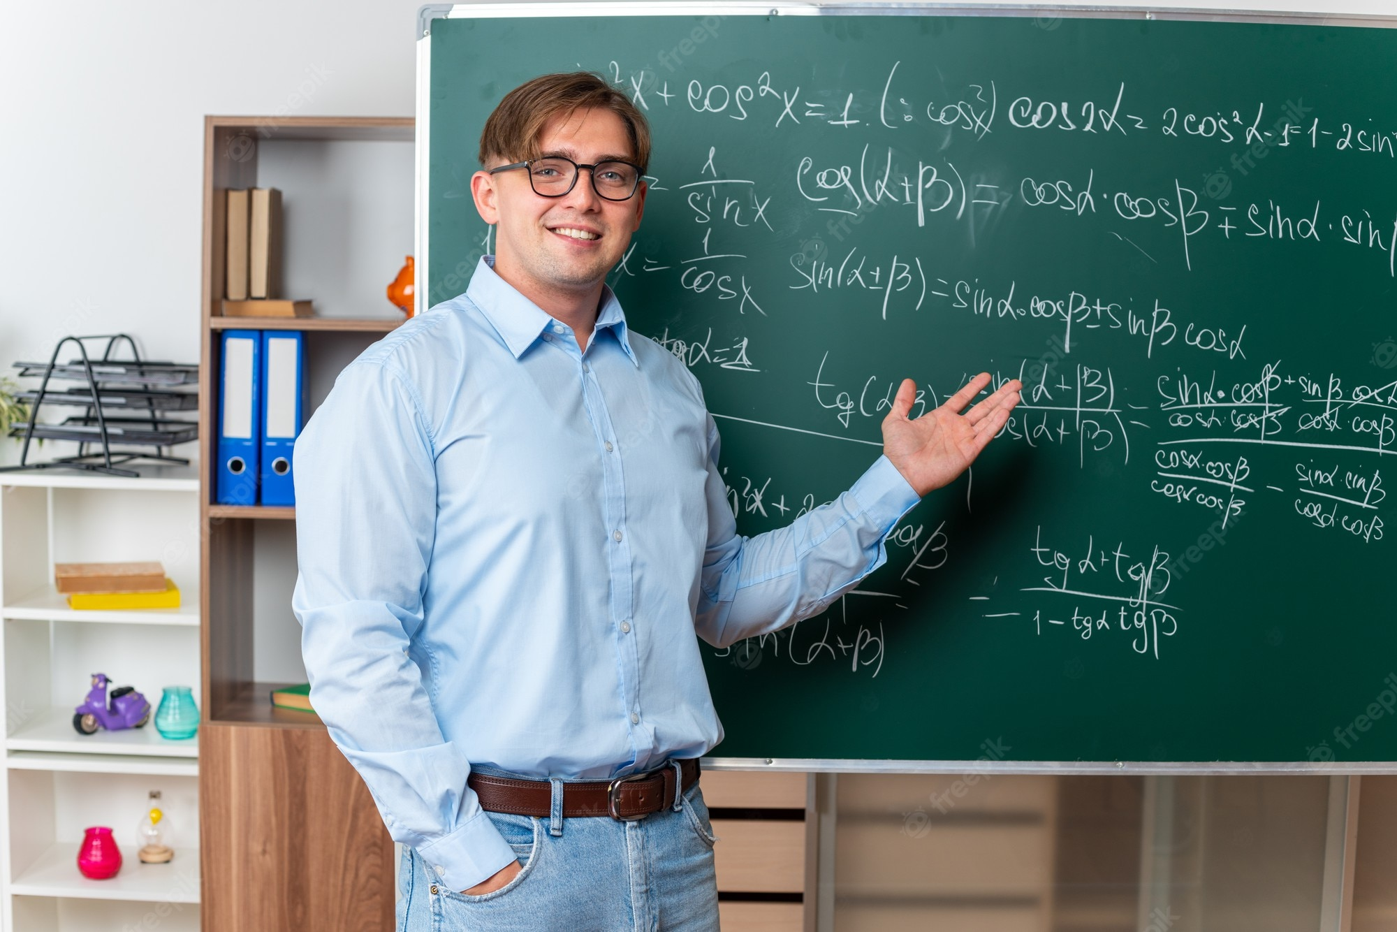
Rationale
Mathematics teaching had largely been seen as following a fairly ‘traditional’ pattern of presentation followed by exercises.
Some called this Triple (E)X teaching:
Exposition
Example
Exercise
Much of this would seem to encourage what Skemp would call ‘instrumental understanding’ rather than ‘relational understanding’.

Slide 6
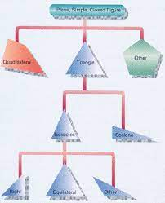
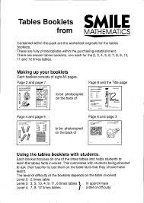
Attempts to deal with teaching mathematics
Individualised learning schemes (eg SMILE)
Discovery / investigations
Programmable ‘microworlds’ (eg logo / scratch)
Collaborative learning
Realistic Mathematics Education
Mastery approaches

Slide 7
Attempts to deal with teaching mathematics
Individualised learning schemes (eg SMILE)
Discovery / investigations
Programmable ‘microworlds’ (eg logo / scratch)
Collaborative learning
Realistic Mathematics Education
Mastery approaches
Seen as unsuccessful
Positively received

Slide 8
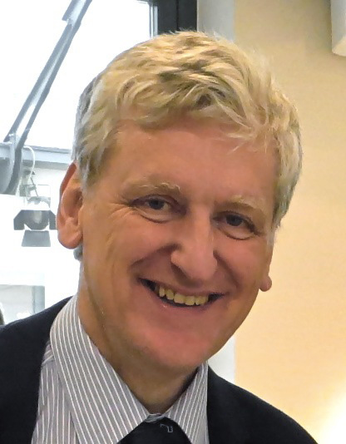
Collaborative learning
Developed by Malcolm Swan https://www.mathshell.org/swan.htm through work at the Shell Centre University of Nottingham https://www.mathshell.com/index.php and various projects:
GCSE resit project
DfE Improving Learning in Mathematics (ILIM) GCSE / A level
Thinking Through Mathematics – Entry level – L2

Slide 10
Principles
Build on the knowledge learners bring to sessions
Expose and discuss common misconceptions
Develop effective questioning
Use co-operative small group work
Emphasise methods rather than answers
Use rich collaborative tasks
Create connections between mathematical topics
Use technology in appropriate ways

Slide 11
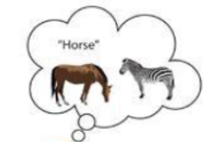
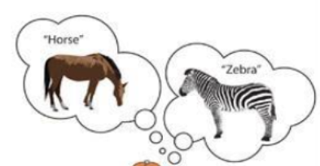
Rationale / theoretical ideas
Expose and discuss common misconceptions
dealing with Piaget’s notion of accommodation
Use co-operative small group work
- drawing on Vygotsky

Slide 12
Use rich collaborative tasks
4.1 Classifying mathematical objects
4.2 Interpreting multiple representations
4.3 Evaluating mathematical statements (eg whether given statements are ‘always true’, ‘sometimes true’ or ‘never true’)
4.4 Creating problems
4.5 Analysing reasoning and solutions

Slide 13
4.2 Interpreting multiple representations

Slide 14
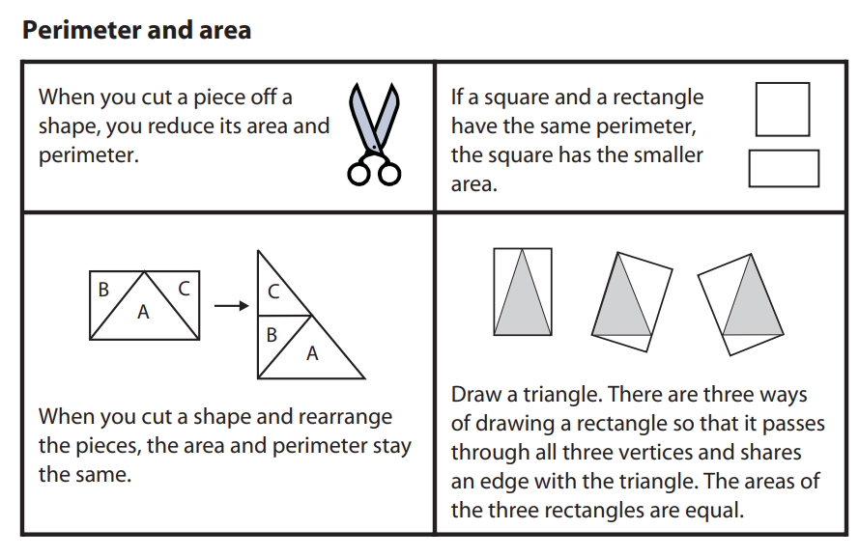
4.3 Evaluating mathematical statements

Slide 15
Resources
ILIM https://www.stem.org.uk/elibrary/collection/2933

Slide 16
References
Skemp, R. R. (1976/2006). Relational understanding and instrumental understanding. Mathematics Teaching in the Middle School, 12(2), 88–95. Originally published in Mathematics Teaching. https://www.atm.org.uk/write/mediauploads/resources/richard_skemp.pdf
Swain, J. and Swan, M. (2007) Thinking Through Mathematics Research Report NRDC/DFE https://dera.ioe.ac.uk/22296/1/doc_3631.pdf
Swan, M. (2006a). Collaborative Learning in Mathematics: A Challenge to our Beliefs and Practices. London: National Institute for Adult and Continuing Education (NIACE); National Research and Development Centre for adult literacy and numeracy (NRDC).

