Slide 1



Storytelling as a ‘Human Skill’ for effective communication and employability in ESOL Teaching
UCET-What Works Teach Meets –ESOL
-
Dr Sarah Telfer-Associate TIRI Professor –School of Education
Notes:
ST

Slide 2


Dr Sarah Telfer
Dr Sarah Telfer
Associate Professor of Education
Initial Teacher Education Programme Leader
The University of Bolton
TEL 01204 903304
Email:
s.telfer@bolton.ac.uk

Slide 3

What’s your Story?
Notes:
Have a look at the people on the screen. What do you think their story is? Everybody has a story to tell!

Slide 4

Follow my Story
Notes:
The use of storytelling draws on the students’ tacit skills already embedded within their everyday use of social media – where they curate their personal stories through pictures, captions and short videos
The next step is to develop these digital storytelling skills to enhance their professional and employability skills – this is the Ah ha moment for students as they already possess both the technological, creative and reflective skills needed to curate their professional stories

Slide 5

What is a Story?
The National Storytelling Network (online, n.d.) defines storytelling “as an ancient art form and a valuable form of human expression”.
Storytelling in its basic form incorporates therefore the telling or writing of stories, which can take the form of oral face to face storytelling, or written stories in print or online.
The words "story" and "storytelling" can be found in a variety of art forms and in different contexts:
a narrative; a tale; a fable;
a recital or an account
real or imagined account of events that describes experience
the terms "story" and "narrative" are often used interchangeably.

Slide 6

Why should we use storytelling in the classroom?
We use different forms of storytelling everyday as we relay stories, our experiences, and re-tell interesting events .
Stories are linguistically rich and can be a good source of new language and Vocabulary
Stories are extremely flexible, stories can be used with all ages of learner and adapted to suit all levels of class
Stories can be used to practise all four skills :reading, writing, speaking and listening
Notes:
Storytelling/role play and creative writing activities can help generate ideas from the learners beginning with speaking and listening skills, using activities in which they tell stories of family histories, relate memories, share problems or discuss issues that may be current and important in their lives

Slide 7

Anecdotes and Storytelling
Teaching is about being able to communicate with another person and interaction between people
Notes:
, for example: finding out what is unknown, sharing personal information, expressing feelings giving or opinions. Rost and Wilson (2013) suggest that short anecdotes take little time to prepare and suggest that many teachers like to ‘mine’ their own personal stories.

Slide 8


The Conversation Theory-Social Brain
Eggins and Slade’s research (1997) indicates that casual conversation often contains anecdotes which contain some small event which elicits empathy or sympathy from the listener.
Notes:
Pask (1976) refers to the ‘Conversation Theory’ in which oral interaction leads to the construction of knowledge through discussion, conversation and dialogue. Why use storytelling? Anecdotes and personal narratives are frequently heard in day-to-day human interaction, so it is reasonable to conclude that this storytelling skill should feature as a component in classroom. In his research of teaching of conversational storytelling skills Jones noted that over a seven-day period of informally monitoring conversation with family and friends, anecdotal stories were used more than forty times. This is due to the fact that everybody has personal experiences and so can relate to personal anecdotes, generating a common denominator in terms of learning. Storytelling uses the social brain, developing social thinking skills within a social and cultural network.
Pask- Conversation Theory-Pask (1976) refers to the ‘Conversation Theory’ in which oral interaction leads to the construction of knowledge through discussion, conversation and dialogue. Eggins and Slade’s research (1997) indicates that casual conversation often contains anecdotes which contain some small event which elicits empathy or sympathy from the listener

Slide 9
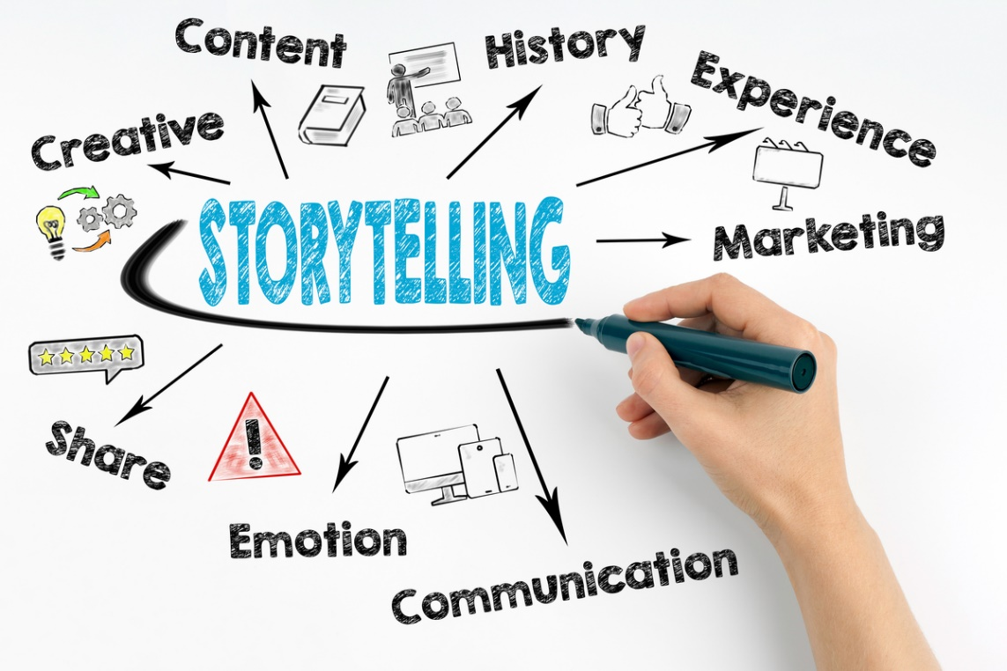
Stories as Ice Breakers

Slide 10

Short Story
Talk to the person next to you and find out:
One interesting/funny/ unusual fact about the person
    Baby in the Teletubbies Sun
    Double jointed
    Dad was an extra in ‘Star Wars’
    Can speak 8 languages
    Won a holiday in a packet of crisps
    Is a virtual boxer
    Is getting married secretly..

Slide 11

Acrostic Story Poem- Auto biography
Sensitive
Artistic
Realistic but open to new experiences
Ambitious
Honest
*REASONS WHY-description
Notes:
2 minutes

Slide 12

Writing an acrostic story poem
Sunny
Perfect
Amazing
Invigorating
Never rains!
Notes:
Example

Slide 13
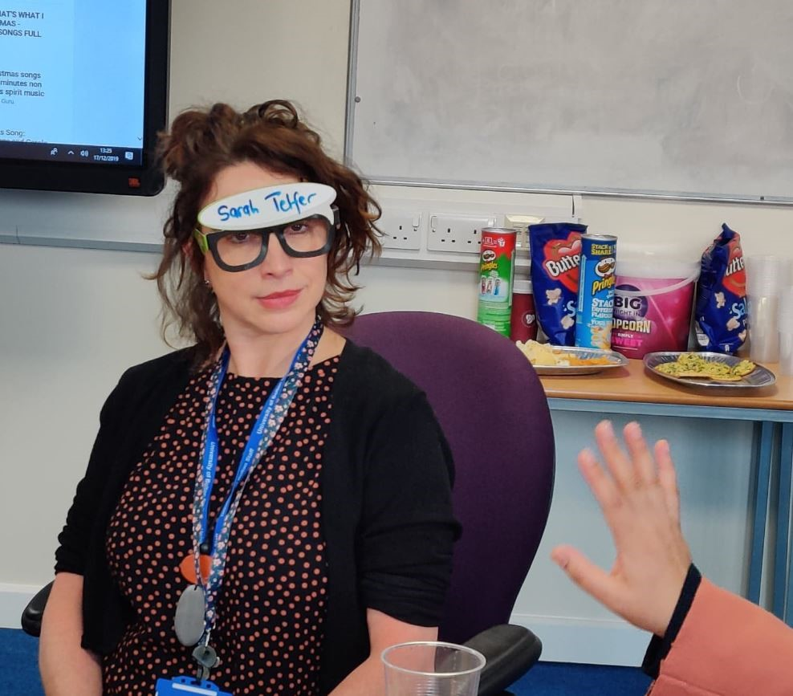

Teacher as Storyteller
Teacher as ‘human’
Notes:
When a teacher tells a story about herself or himself to the class it makes them seem ‘more human’. Elicits a story in return. Vygotsky’s social interaction method of teaching (1978) encourages teachers to create an interactive classroom environment which can be integrated in by the teacher and learners sharing personal anecdotal stories., as part of classroom practice.

Slide 14

Have you ever…Story ?
Write 3 questions to ask your teacher/partner :
Have you ever… (experiences)..?
met someone famous?
got lost in a strange city?
seen or heard a ghost or had any kind of supernatural experience?
locked yourself out of your house?
lost your wallet, passport or something critical/important?
have you ever dreamt something that became true?
have you ever fallen asleep on the train or bus and missed your stop?

Slide 15

Tell me about.. Story
Your happiest movement
Your scariest moment
Your most embarrassing moment
Your most surprising moment
Your best Sporting Triumph

Slide 16


Every Picture TELLS A STORY
Notes:
Activity 1

Slide 17

Every window tells a story..
Window Swap
WindowSwap (window-swap.com)
‘Open a new window somewhere in the world’
Notes:
Encourage them to take a photo/video outside their windows at home and share them the following week.
Who lives here?
Storytelling?
Take pictures of your own window and share

Slide 18

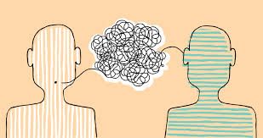
Why Storytelling? Storytelling as a Human Skill
Storytelling is a ‘human skill’, such skills are defined as our ability to relate to one another and include a range of cognitive, social, and emotional skills, such as creativity, critical thinking, and communication (Coursera,2023, The Job Skills of 2023).
We are wired for communicating through and learning from stories (Gibson 2012)
Notes:
More widely Stories help pass down knowledge, traditions, and cultural values.
The stories that our students retell about their experiences in the classroom help pass on experiential knowledge about their challenges, successes, working relations and further questions – retelling personal experiences in this way helps to build human connections between people.
Sharing experiences, even fictional ones, helps us understand each other better. So, storytelling isn't just a skill; it's a superpower that binds us together and makes information stick.

Slide 19







T-shirt story activity-Journey to becoming a teacher
Notes:
Sarah – discuss the t-shirt story idea

Slide 20
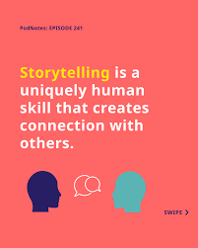
Why Storytelling? Storytelling as a Social Interaction Tool
Dugan (1997) suggests that literacy instruction is most effective when developed through social interaction and collaboration with others.
Storytelling and language learning are inextricably linked as language is a tool of social and cultural theory, in which learning takes place in a socio-cultural context (Dewey 2016; Vygotsky, 1978).
Storytelling uses the social brain, developing social thinking skills within a social and cultural network. Therefore, students learn the social aspects of language through observation and participation in storytelling (Craig et al, 2001).
Notes:
ST

Slide 21

Why Storytelling? Employability Tool
Communication, storytelling, and ‘influencing’ remain in the top ten fastest-growing human skills for employability, illustrating the continued importance of developing learners’ ability to share information and use skills of ‘persuasion’ to effectively communicate with others (Coursera, 2023).
Notes:
Storytelling is like the secret sauce of employability skills! It adds flavour and depth to your professional persona. Here's why:
Communication Skills: Storytelling showcases your ability to articulate ideas coherently. It's not just about what you say, but how you say it. Employers value clear and engaging communicators.
Relatability: Stories make you relatable. People connect through narratives, and sharing your experiences helps build a personal connection with colleagues, clients, or superiors.
Memorability: A well-told story about your achievements or challenges is more likely to stick in people's minds.
Problem-Solving: Many stories involve overcoming challenges. By sharing how you tackled a problem or navigated a difficult situation, you demonstrate your problem-solving skills.
Emotional Intelligence: Stories often tap into emotions. Being able to convey and understand emotions is a key aspect of emotional intelligence, a trait highly valued in the workplace.
Engagement:. It's a powerful tool to maintain attention and drive your message home.
Persuasion: A compelling story can be persuasive. It's not just about presenting facts; it's about creating a narrative that influences opinions and decisions.
Cultural Fit: Sharing stories about your experiences and values helps potential employers gauge if you'll be a good fit for their organization's culture.
Leadership: Leaders often use storytelling to inspire and motivate their teams. If you can tell a story that captivates and motivates others, you're showcasing leadership qualities.
Networking: When networking or in interviews, stories help you stand out. Instead of just listing accomplishments, you're painting a picture that people can remember and associate with you.
So, whether you're in a job interview, a team meeting, or networking event, don't underestimate the power of a good story! It's a versatile skill that can set you apart in the professional world.

Slide 22

Employability Post FE- Office of Students – B Conditions (employability)
Notes:
Discuss wider OfS policy and drivers behind the research
Discussed value of the research for wider skills
Here we can connect to the Office of Students B conditions and graduate outcomes for employability
Embedding the use of storytelling into teacher trainer curriculum is a beneficial pedagogical tool that reaches beyond the bounds of formal curriculum delivery, and where we as teacher educators currently feel the pressure to do more than ‘simply teach’,
As teacher educators within Higher Education we work within the regulatory requirement set out by the Office of Students is the independent regulator of higher education in England. It regulates universities and colleges to ensure they deliver “positive outcomes” for past, present and future students
Condition B3 of the Office for Students' (OfS's) regulatory framework requires that: 'The provider must deliver successful outcomes for all of its students, which are recognised and valued by employers, and/or enable further study
Our research using story telling to develop students employability skills directly responds to these regulatory requirements and can be measured and quantified

Slide 23
Anecdotes as a Pedagogic Tool
1 Personal story context/background
Teacher sets up the background context to the story;
2 Anecdotal example/experience
Teacher gives an anecdotal example of what happened
3 Pedagogic point/moral point/practical point
Teacher follows with a pedagogic point
Notes:
Background to my EdD
My doctoral research presents a strong argument for the use of anecdotal stories in all subject areas. Such stories can be used to draw learners in, frame an activity and illustrate a pedagogic point. An effective model can be seen to operate as follows:; she gives an anecdotal example of what happened; she follows with a pedagogic point. Future areas worthy of further exploration might be to explore how storytelling activities, in particular the use of personal anecdotes, can be used as a pedagogic tool in other subject areas. Rudyard Kipling wrote that if history were taught in the form of stories it would never be forgotten, so might stories aid learning retention in other topic areas?
Give example from TESOL teaching practice.

Slide 24

Why Storytelling? Research Tool
Story telling is an accepted and embraced area of research which is supported by a strong and growing body of evidence (deJager et al 2017; Hill Bailey and Tilley, 2008;Kendal, 2023, Lewis and Hildebrandt 2019.)
Notes:
LC

Slide 25
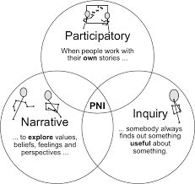
Why Storytelling? Narrative Enquiry
Stories as a Research Tool
Narrative enquiry is grounded in a ‘view of human experience in which humans, individually and socially, lead storied lives..by stories of who they and others are, and as they interpret their past in terms of these stories’.. (Connelly *& Clandinin, 2006:477)
Narrative inquiry records the experiences of an individual or small group, revealing the lived experience or particular perspective of that individual, usually primarily through interview which is then recorded and ordered into a chronological narrative.
Notes:
LC

Slide 26


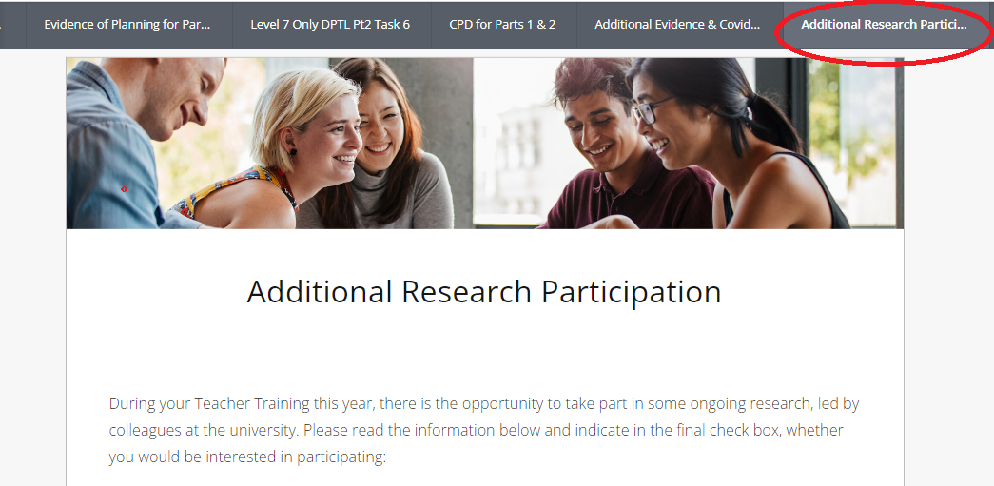
Notes:
Briefly introduce Pebble pad
Include image from the student - here !!!!

Slide 27
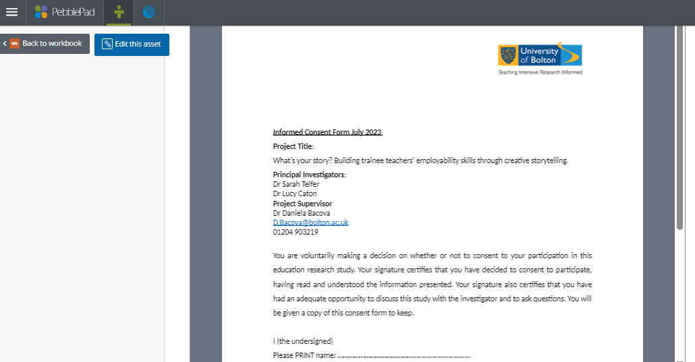
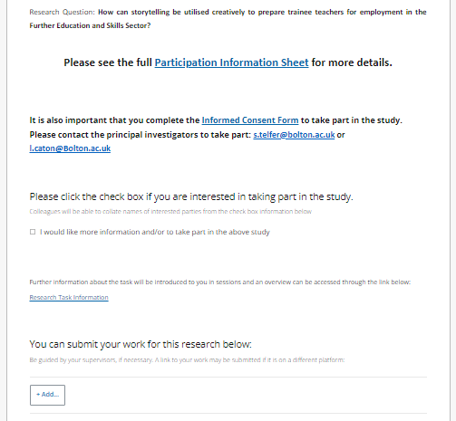
Ethical Considerations

Slide 28

Storytelling as a Reflective Tool Task- Your Trainee Teacher Journey
Use storytelling as a reflective and pedagogical tool to create a narrative of your journey as a trainee teacher.
The importance of using a reflective storytelling to outline your personal journey as a trainee teacher will enhance your professional skills and prepare you for a future job interview.
Engaging with the process of creative storytelling will not only develop your competencies in an educational setting but they are highly sought after by employers in the workforce. Being able to creatively and clearly communicate your unique selling points, through critical reflection demonstrates continued professional learning and a commitment to betterment.
You are encouraged to use creative approaches for this task and might consider the following:
Digital storyboards; video logs/online blogs; a range of crafts, tapestry; scrap book; poster, pictures/photographs/drawings; poetry/song and more.
Notes:
Show an example of our research. ST. Example from Nadia.

Slide 29

Mosaically- My Story Journey –Nadia
Notes:
This is an example of a storytelling journey created using software called mosaically. ST.

Slide 30
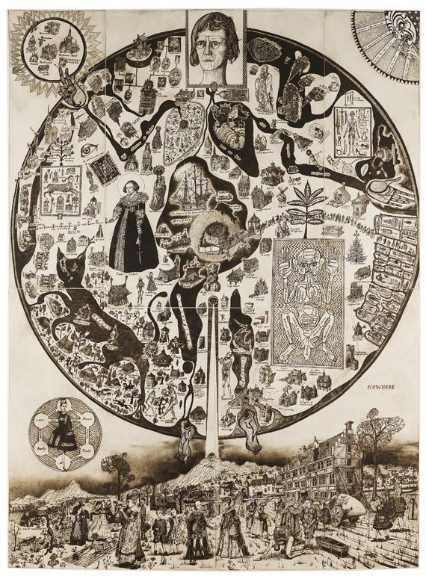
Storytelling Ideas & Inspirations
Faith Ringgold's (is an American Artist) has some great story quilts to inspire students - her work in the met museum below
https://www.metmuseum.org/art/collection/search/485416
Famous vases that illustrate a story or a tale
https://tripod-journal.bezalel.ac.il/en/six-vases-that-tell-a-story/
Grayson Perry-Mappa Mundi –Maps
Maps are beautiful storytelling vehicles. The fusion of information, art and science creates a visual device for storytelling.
Notes:
How we are inspiring our students – examples of stories
For our research with the ITE post 14 students, we have inspired them with some famous artifacts that tell stories through art based approaches for example maps, vases and textiles that have been used as beautiful storytelling artifacts
Artifacts that tell stories have been around for 1000 of years. Here are some examples, my favourite is Faith ringgolds (American Artist) has created a story quilt that is showcased at the Met Museum in NYC. Her quilt tells a stories about African American life, history and identity, especially in her resident community of Harlem, just as the stories evoke the Black traditions of folk tales both written and oral, quilting has long been associated with domestic labour, women’s work and African American craft
We hope students can take inspiration and tell their stories from the classroom in creative and inspiring formats using digital means

Slide 31
References
Dewey, J., (2016). Excerpts from democracy and education (1916). Schools, 13(1), pp.127-139
Dugan, J., (1997). Transactional literature discussions: Engaging students in the appreciation and understanding of literature. The Reading Teacher, 51(2), pp.86-96.
Elbaz-Luwish, F. (2002). Writing as inquiry: Storying the teaching self in writing workshops. Curriculum Inquiry, 32(4), 403-428
Elbaz-Luwish, F. (2007). Studying teachers’ lives and experiences: Narrative inquiry into K-12 teaching. In J.D. Clandinin (Ed.), Handbook of narrative inquiry (pp. 357-376). Thousand Oaks, CA: Sage Publications.
Gibson, R. (2012) 3 reasons to master the art of storytelling. [online]. Available at: http://www.inc.com/riley-gibson/3-reasons-every-start-upshould-tell-more-stories.html [accessed 27th January 2023].
Kendall, J. and Kendall, K. (2012) 'Storytelling as a Quaftative Method for IS Research: Heralding the Heroic and Echoing the Mythic', Australasian Journal of information Systol%, 17. Available at: hittps://C01. org/10.3127/alis. V172.697.
Kim, J. (2016). Understanding narrative inquiry: The Crafting and analysis of stories as research. Los Angeles, CA: Sage Publications.
Lyle, E. (2016). The role of counter-narratives in the recognition of identity: A curricular perspective. Journal of the Canadian Association for Curriculum Studies, 14 (2), 33-42.
Vygotsky, L. S. (1978). . Massachusetts: Harvard University Press. Mind in society: The development of higher psychological processes

Slide 32
Other ideas to storytelling ideas to use with students
Interactive Dioramas: Construct miniature scenes in boxes or enclosures that can be viewed from multiple angles. These dioramas can be interactive, allowing to physically engage with the narrative.
Illustrated Journals: Combine written narratives with sketches, drawings, and mixed media in a journal format. The visuals complement and enhance the written storytelling.
Storyboard Art: Develop a visual storyboard that lays out key learnings and experiences
Collage Stories: Use cut-out images from magazines, newspapers, and other sources to create collages that tell a story through a combination of visuals
Puppet Theatre: Craft puppets and build a miniature stage to act out a story. This can be a fun and engaging way to retell narratives, especially for children
Photo Montages: Combine photographs with captions or short descriptions to create a visual narrative that captures a specific event or journey (no children's faces)
Notes:
If we have time – reference slides .Lucy.

Slide 33
References
Bailey, P.H. and Tilley, S. (2002) ‘Storytelling and the interpretation of meaning in qualitative research’, Journal of Advanced Nursing, 38(6), pp. 574–583. Available at: https://doi.org/10.1046/j.1365-2648.2000.02224.x.
Barkhuizen, G. (2014) Research Timeline: Narrative research in language teaching and learning. Language Teaching, 47(4), 450-466.
Connelly, F.M.,& Clandinin, D.J. (2006) Narrative inquiry. In J. L. Green, G. Camili, & P. Elmore (Eds.), Handbook of complementary methods for research in education(pp.477-488) . Mahwah, NJ: Lawrence Erlbaum Associates.
Connelly, F.M.,& Clandinin, D.J. (1990). Stories of experience and narrative inquiry. Educational Researcher, 19 (5), 2-14.
Coursera (2023) The Job Skills of 2023. The Fastest-Growing Job Skills for Businesses, Governments, and Higher Education Institutions. eBook-Job-Skills-of-2023.pdf (coursera-for-business.org)
Craig, S., Hull, K., Haggart, A.G. and Crowder, E., (2001). Storytelling addressing the literacy needs of diverse learners. Teaching exceptional children, 33(5), pp.46-51.
De Jager, A. et al. (2017) ‘Digital Storytelling in Research: A Systematic Review’, The Qualitative Report, 22(10), pp. 2548–2582. Available at: https://doi.org/10.46743/2160-3715/2017.2970.

