Slide 1
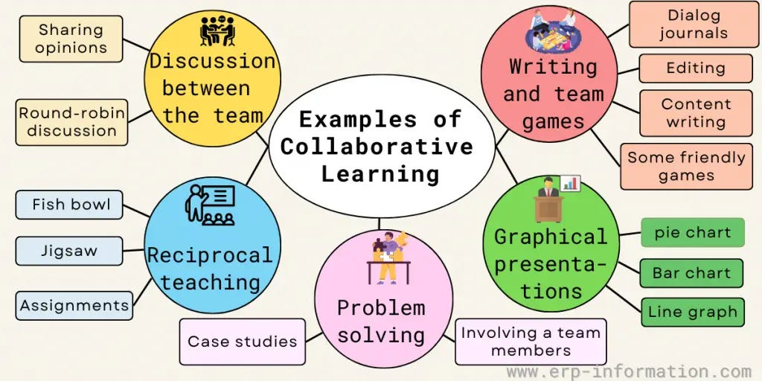
What is subject specific pedagogy in ESOL?

Slide 2
What is pedagogy?
https://answergarden.ch/3864017
Notes:
Which teacher skills are we referring to when we talk about pedagogy?

Slide 3
What is pedagogical knowledge? (Shulman 1986)
classroom management
organize learning activities
timing and grouping students
assessment for/of/as learning
feedback and feed forward
questioning strategies
planning
Notes:
what is pedagogical knowledge? Collaborate?
What are basic principles of pedagogical knowledge? (classroom management, organize activities, allocate time and turns, structure assignments, ascribe praise and blame, formulate the levels of their questions, plan lessons, and judge general student understanding
What’s missing? Content

Slide 4
Content knowledge
How teachers decide:
what to teach
how to represent it
how to question students about it
how to deal with problems of misunderstanding
Notes:
This is different from pedagogy knowledge. It’s to do with Where do teacher clarifications come from?
What are the sources of teacher knowledge? What does a teacher know and when did he or she come to know it? How is new knowledge acquired, old knowledge retrieved, and both combined to form a new knowledge base?

Slide 5
Pedagogical content knowledge
‘ways of representing and formulating the subject that make it comprehensible to others’ (Shulman 1986:9)
What makes learning specific topics easy or difficult?
What understandings, experiences and misconceptions do students bring to their lessons?
How to correct misconceptions and utilise students’ experiences and understandings to promote learning?
Notes:
So what does this look like for ESOL teachers?
Collaborate: What do ESOL ss need to know?
Need to know vs nice to know.
How do you decide? When do Ss need to learn it? (sequencing the curriculum)
How does language work? Why does it work this way? Need to be able to clarify voc, grammar and pron so Ss can understand it and apply it.

Slide 6
Underlying principles of ESOL pedagogy
Activate prior learning.
Set a context for all new language – ‘no context, no meaning’.
Develop learner autonomy.
Keep teacher talking time (TTT) to a minimum.
Avoid lengthy explanations.
Textbook, personal experiences, stories etc.
Bilingual dictionaries, phonemic script, hot cards, peer teaching.
Gestures to praise, indicate errors, 1 or 2-word instructions.
Communicative activities and feedback.
Notes:
10 (25)
This can be done in L2 or L1, depending on level and what the learning relates to. New learning is built on foundations of prior learning. Is the info you’re getting now begin written in your head on a blank slate, or is it connecting in some way with your previous knowledge, thoughts, prejudices?
Use textbooks, Ss’ experiences, your experiences, set up a story etc. to do this. Ss bring a vast range of knowledge, life experience, memories, worries, moods, fears, needs to the classroom. Need to tap into these to make learning relevant. Make the context relatable, relevant and meaningful for Ss. Breakout rooms – choose a context for teaching (assign 1 to each group): s. present for habits and routines; the following lexis (rare, reef, extinct, ice flow)
People learn by doing things themselves, rather than being told about them. How can you do this? (bilingual dictionaries, phonemic script, sub-skills such as deduce meaning from context, set up activities, then monitor discretely, keeping hot cards for follow up.
How can you do this? (use gestures to praise, indicate & correct errors,
Ability to use a language appears to be a skill you learn by trying to do it. So language Ss need to be exposed to chunks of language and have opportunities to play with and use that language by communicating with each other in a safe environment. They need to communicate with a variety of people and get feedback on how successful their attempts at communication have been.
Teaching is ultimately about working with people, and about remaining alive to the many different things that go on when people embark on new learning.

Slide 7
Sequencing the curriculum
Which comes first?
Receptive or productive language?
Speaking or writing?
mug, cup, goblet, glass, thermos, tankard, chalice
MFP
Meaning
Form
Pronunciation
Notes:
Which order would you teach these words in? Are there any you wouldn’t teach a general ESOL class? Why? (frequency) This is same for presenting a structure as well as teaching vocab.

Slide 8
Some ideas
Information gap activities e.g., crossword, timeline, running dictation, paired mime, pictures)
Word classes (morphology)
Writing & speaking frames
Collaborative learning
Notes:
Breakout rooms: Brainstorm word classes. Morphology on zoom whiteboard. care; record (n,a,v,discuss relationship between word stress and nouns & verbs). Care (n,v,ax3,adv,)
https://docs.google.com/document/d/1zmblUAzBnJEuSvQbOKlyAaAbMYrIFWiP0kIAN2gnLU0/edit?usp=sharing Info gap timeline 1
https://docs.google.com/document/d/1MXhNbxhcr28a4iLO0LpL3FVeLIGjwLrWUy8t194bqnE/edit?usp=sharing info gap timeline 2
Also representing info in different formats e.g., text to timeline, graph, diagram etc.
Go to armoured penguin and create info-gap crossword https://www.armoredpenguin.com/crossword/Data/2023.10/0308/03081253.740.pdf
https://decoda.ca/back-to-basics-writing-frames/ - framed paragraphs resource.

Slide 9
Colour coding
present
past
continuous suffix
past participle
He walks to work every day
He is walking to work
He walked to work for 20 years
He was walking to work when he found the dog.
He has walked to work for the past 18 years
He has been walking to work and that’s why he’s tired.
He had walked to work, and he was tired.

Slide 10
References & useful resources
Scrivener, J. Learning Teaching: The essential guide to English language teaching 3rd edition. Macmillan.
Shulman, L. (1986) Those Who Understand: Knowledge Growth in Teaching. Educational Researcher. 15 (2) pp. 4-14
Watcyn-Jones, P. (2001) Vocabulary Games 1 & 2 Penguin
Any Watcyn-Jones book
Oxford English Resource books for teachers series.
https://www.et-foundation.co.uk/professional-development/maths-and-english/english-for-speakers-of-other-languages-esol-support/
https://www.natecla.org.uk/content/635/Useful-ESOL-teaching-websites
Notes:
Includes free printable resources you can use.

Slide 11
Useful resources
https://www.skillsworkshop.org/category/link-types/learning-resources-external-links/printable-resource-sites/printable-esol-resour
https://www.teachingenglish.org.uk/resources
https://www.bell-foundation.org.uk/eal-programme/guidance/effective-teaching-of-eal-learners/
https://www.skillsworkshop.org/category/esol/esol-writing/esol-writing-text-focus-composition

