Slide 1
drill, produce, structure, practice, form, present, meaning, used to
Notes:
These are important words for today's lesson, so I want you to remember them. You've got 1 min to memorise them.

Slide 2
Building context
'No context, no meaning'
Notes:
Mantra - no context, no meaning.

Slide 3
Explain
why its’ important to contextualise language
Analyse
PPP approach to presenting a structure
Apply
PPP to a lesson presenting a structure

Slide 4
Notes:
We’re going to look at PPP as a possible approach for presenting a structure.
Structure: used to
Use: to describe events that happened habitually in the past but no longer happen.
Form: used to + bare infinitive
I recently bumped into an old friend of mine. Hadn’t seen him for 10 years.

Slide 5
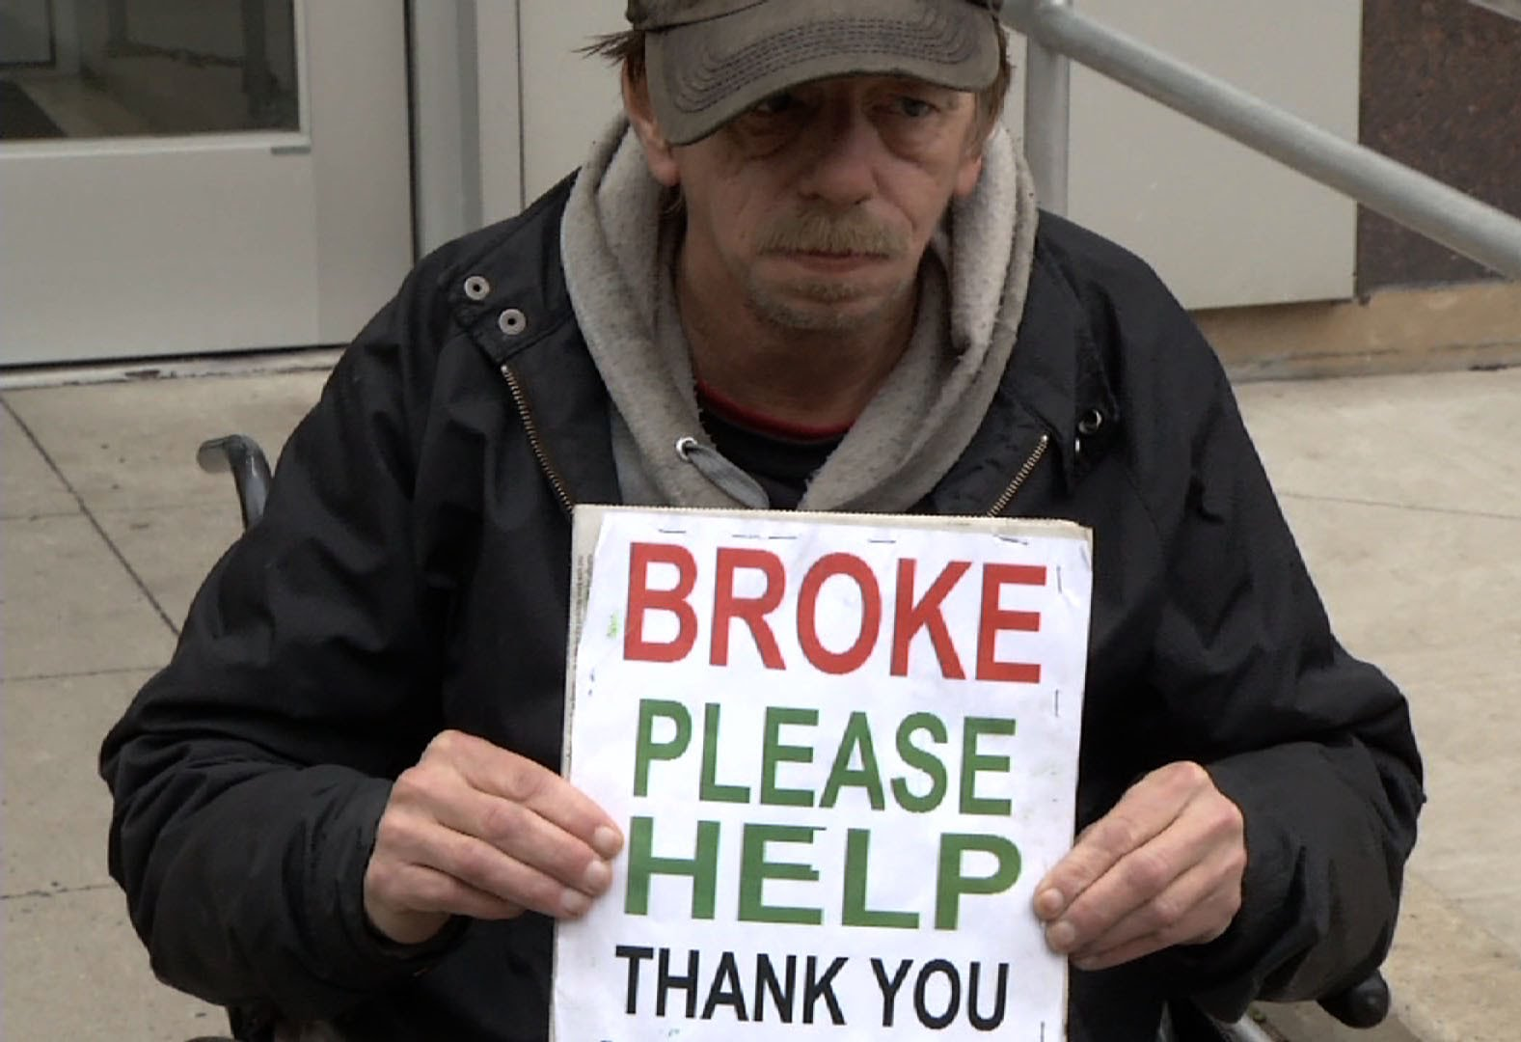
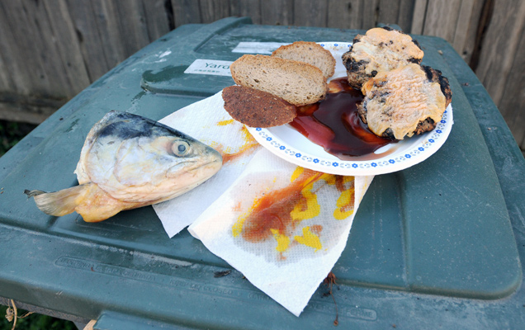
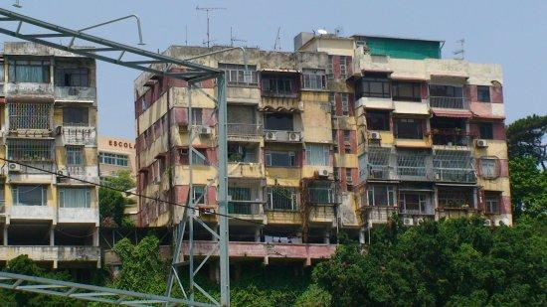
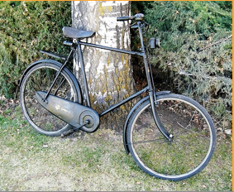
2022
Notes:
This is what he told me about his life now.
Elicit what he eats, where he lives, how he gets around, how he’s feeling.
CCQs: When is this happening? Now
How often does this happen? frequently
Explain that you’re really shocked, as just a few years ago you heard he was living a very different life.

Slide 6
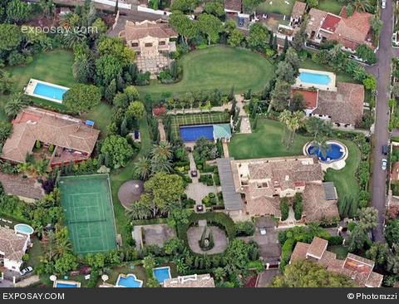
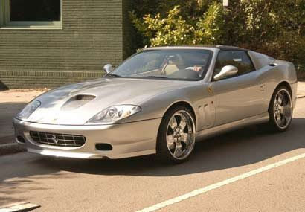
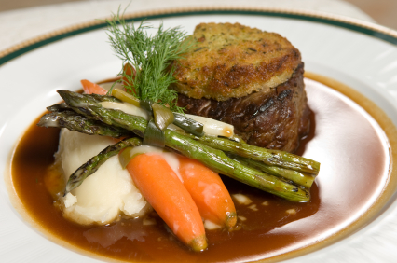
1980-2013
Notes:
This is what his life was like before.
Ask where he used to live, how he used to get around, what he used to eat and drink how he used to socialise.
Sentences to w/b
Meaning: CCQs: When did this happen? Past
Does it still happen now? No
How often did it happen? Very often/habitually

Slide 7
I used to live in a big house.
I used to drive expensive cars.
I used to eat good food.
I used to drink champagne.
I used to have lots of friends.
used to + base form
didn’t use to + base form
Notes:
Meaning: CCQs: When did this happen? Past
Does it still happen now? No
How often did it happen? Very often/habitually
Analyse form used to + base form. Elicit negative form
Pron - mark stress. Note unstressed ‘to’. Drill sentences from w/b
Write 'I used to live in a big house' on w/b. Elicit structure. (Presentation)
Ss mark sentence stress. Drill. (Practice)

Slide 8
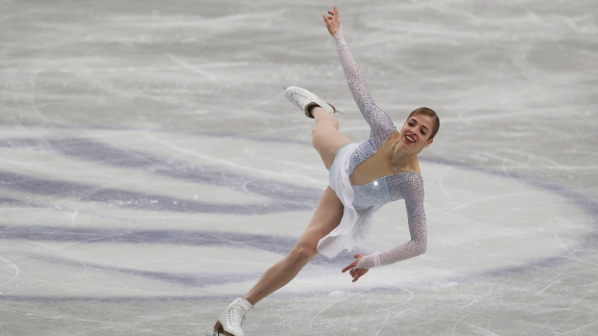
Substitution drill
When I was young I …
Notes:
Whole group drill for controlled practice – make sentences that are true for you.
I used to ice skate

Slide 9
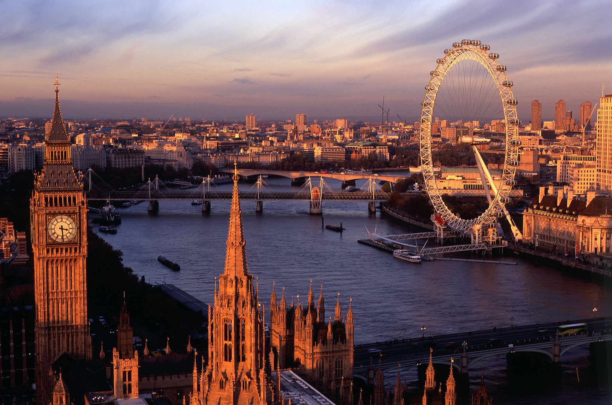
Notes:
I used to live in London

Slide 10
Notes:
I used to walk to school

Slide 11
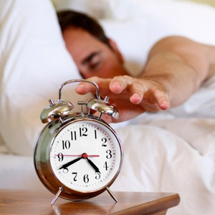
Notes:
I used to get up early

Slide 12
What are the stages of PPP?
https://padlet.com/sboodt/oougash0mkmb6qrk
Notes:
Stages of PPP

Slide 13
Present-Practise-Produce
Set context
Clarify meaning
Clarify form
Pronunciation
Controlled practice
Personalised (freer) practice
Notes:
Inductive approach: T gives Ss lots of examples, Ss work out rules.
Contextualisation to activate schemata: start with gist task; then detailed task; then focus on language (e.g., form of regular past tense verbs, spelling, pron). from this students build rules and finally teacher clarifies.
Deductive approach: T gives Ss the rules and then works with them to produce language.

Slide 14
Building context
'No context, no meaning'
Notes:
Mantra - no context, no meaning.

