Slide 1
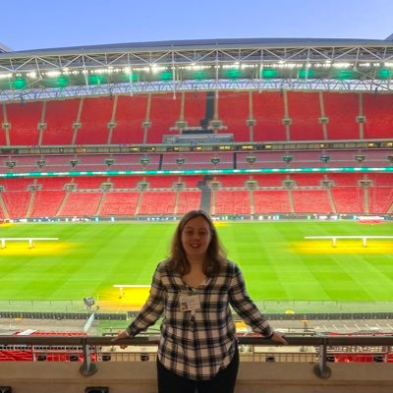
Disability sport and adaptive teaching
Sophie Coyne

Slide 2
How is disability defined? (Definition, facts and statistics
According to the Oxford Learner Dictionary, disability is defined as “a physical or mental condition that makes it difficult for somebody to do some things that most other people can do”
People with disabilities are twice as likely to be inactive compared to their non-disabled peers (Activity Alliance, 2022).
1 in 5 people (20%) in the UK are classed as having a disability (Sport England, 2016)
Over 50,000 disabled young people throughout the country were given opportunities to take part in sport and physical activity in 2021/22 through their SEND Schools through Panathlon (A disability sport charity).
Read about the work Panathlon do in Merseyside and the impact it is having here. Our local Panathlon Events Officer is now James Dixon from Greenbank Sports Academy (formerly it was Steve Sullivan). Panathlon pays tribute to disability sport pioneer Steve Sullivan - Panathlon Challenge | Panathlon Foundation Ltd. Registered Charity: 1072638

Slide 3
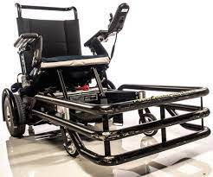
What forms of disability sport currently exist?
Powerchair Football – players have a front bumper and the aim is for them to use the side of it to pass the ball to their teammates. There is 5 speeds on the powerchairs, 5 being the fastest and 1 being the slowest.
Ambulant Disability Football – for people who are physically mobile but also may have learning disabilities (ADHD, Autism, Aspergers, Downs Syndrome, Autistic Spectrum Disorder, Epilepsy, Amputees, Spina Bifida – the list is endless!)
Deaf/Hard of Hearing Football – for people with hearing impairments (The FA also have their own pathway for the amputee England teams).
Amputee – for people with only 1 leg or arm (The FA also have their own pathway for the amputee England teams)
Visual Impaired Football – A form of football with a bell inside the football designed for those who cannot see at all or have limited vision. (those who cannot see anything will usually have a guide for their safety).

Slide 4
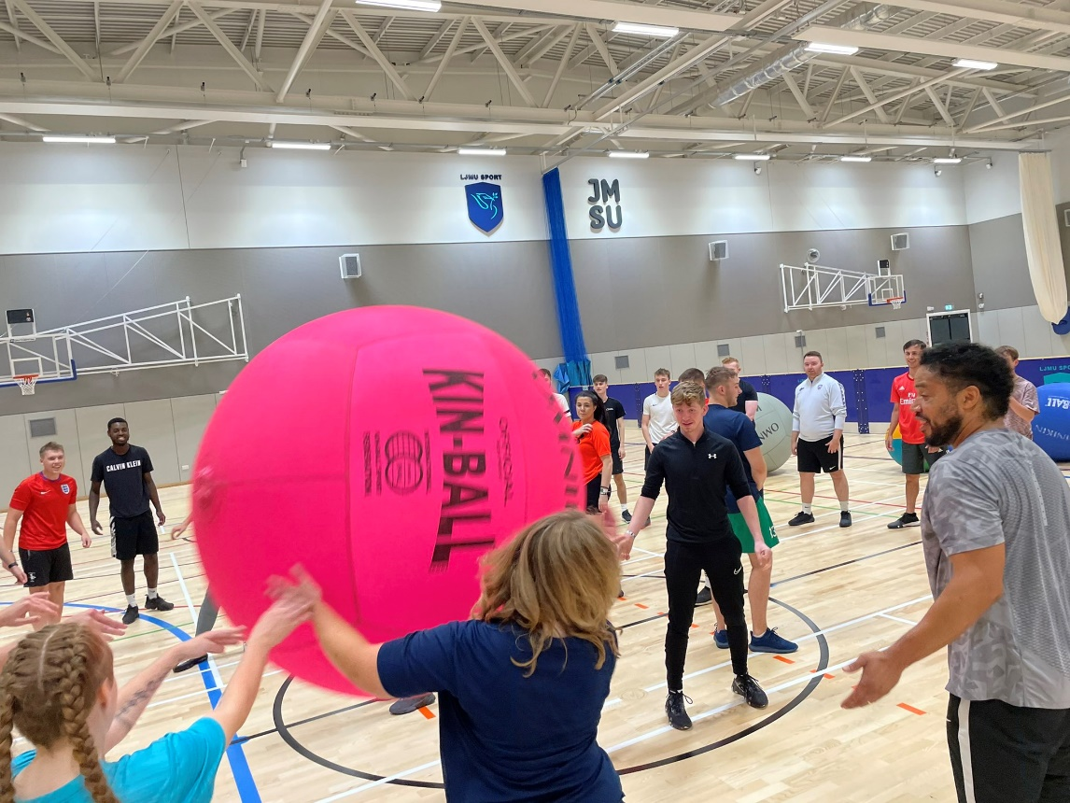
Other types of disability sports
Sitting volleyball – volleyball but sitting down.
Boccia – a game of tactics and strategy. Three types of ball – Jack (white), Red and Blue. Players propel the balls (red always starts) and try to get their balls closer to the jack than their opponent. A point is offered for every ball of their colour that is closer to the jack than their opponents.
New Age Kurling – played on ice in the paralympics but in grassroots, played on a mat, on your knees and push the stone onto the mat, you can score so many points depending on what number you land on (5,10,25 and 50 usually).
Kinball – probably the second or third most accessible sport as anyone can play. Even wheelchair users (with correct safety precautions in place).

Slide 5
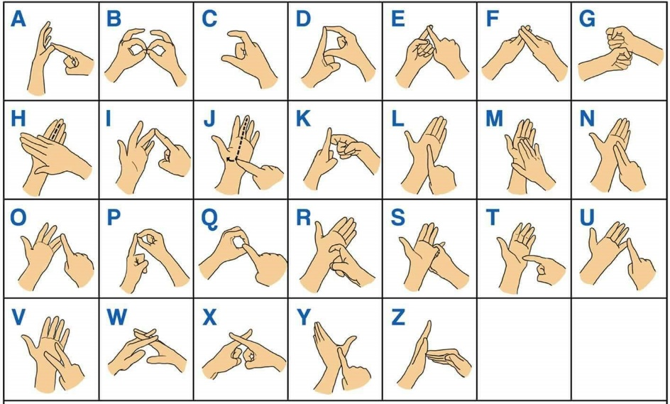
What to consider when working with people who have disabilities
Does a deaf person require an interpreter for BSL (British Sign Language) and are they able to lip read? – even knowing the basic signs yourself can help to break the communication barrier!
The STEP Principle (Space, Task/Time, Equipment, People) – all these things put together can make a really good inclusive session!
The person’s condition and how it affects them – in other words, know your participant! (for example, if they have a memory issue that comes with their condition, allowing them more time for the task to be done).

Slide 6
THE STEP PRINCIPLE
STEP – Step stands for:
Space – How much space do you have?
Task – what are the participants/coaches being asked to do
Equipment – what equipment do you need? (cones, footballs, goals etc.)
People – who are your participants? (do they come from a minority ethnic background – disability, BAME, mental health).
All these things need to be considered in order to create a great session!.

Slide 7
TASK! – Using the STEP Principle, think about how this may apply in your current setting.
Think about:
The students you teach/coach
How could you adapt an activity you already do in your setting to suit those students needs?
STEP
- Space - Task - Equipment - People.

Slide 8
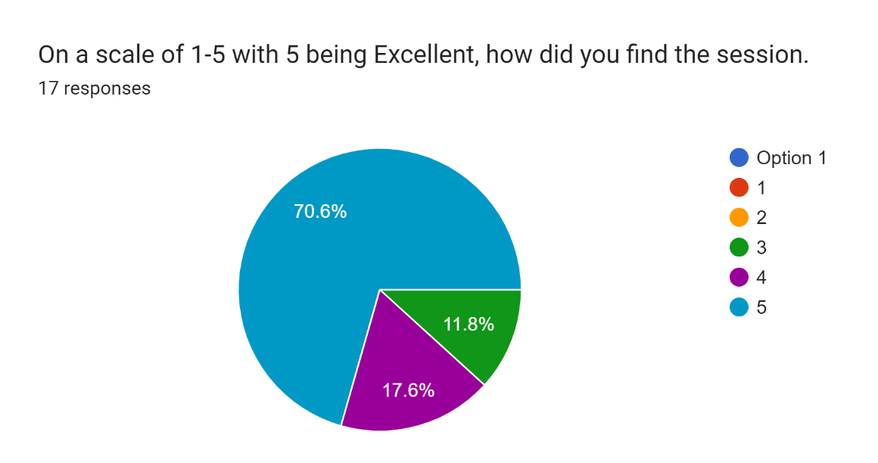
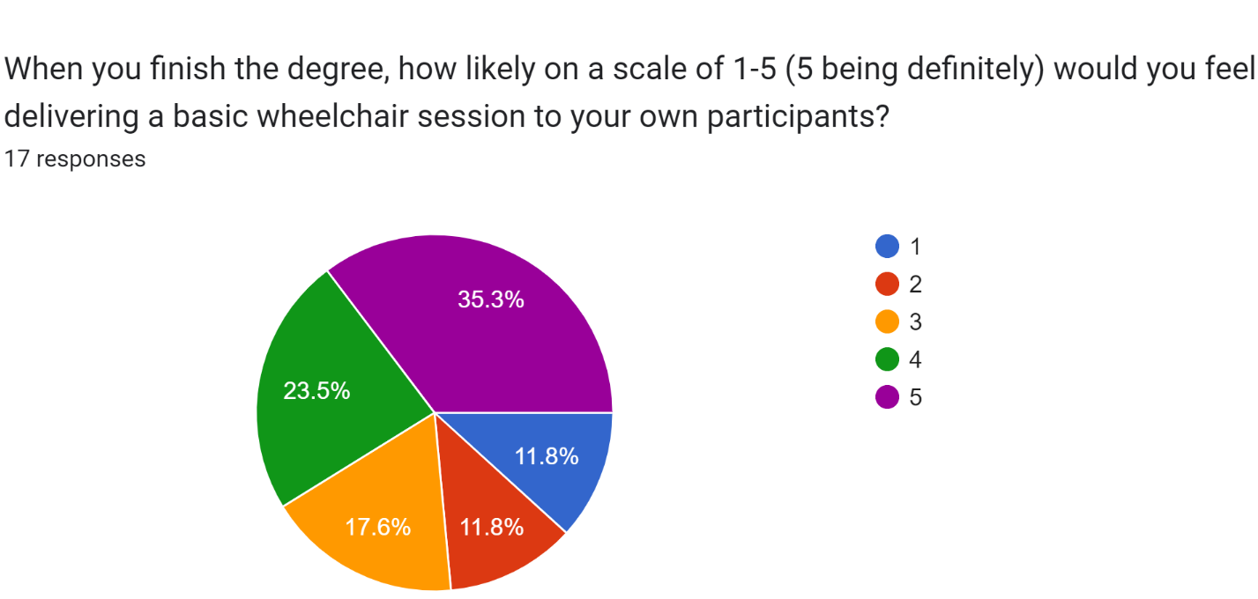
The Data
Out of 100 students asked to do the survey (not all would do the survey) and out of the 17 that responded about last week’s disability sport session delivered at LJMU . We (myself and lecturers at LJMU) found that:
88.2% of Level 5 Sports Coaching and Physical Education Students found the session useful.
76.4% of those students would consider running disability sport sessions to their own participants once they have completed the degree and progressed into further employment.
Already, we are one step closer to making inclusion a daily occurrence and not just a one off – all from a 2 hour session!.

Slide 9
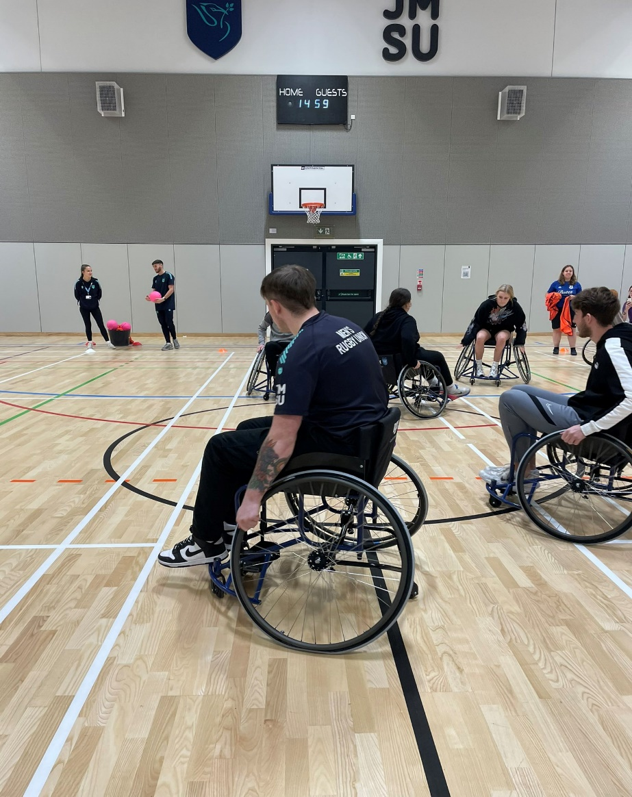
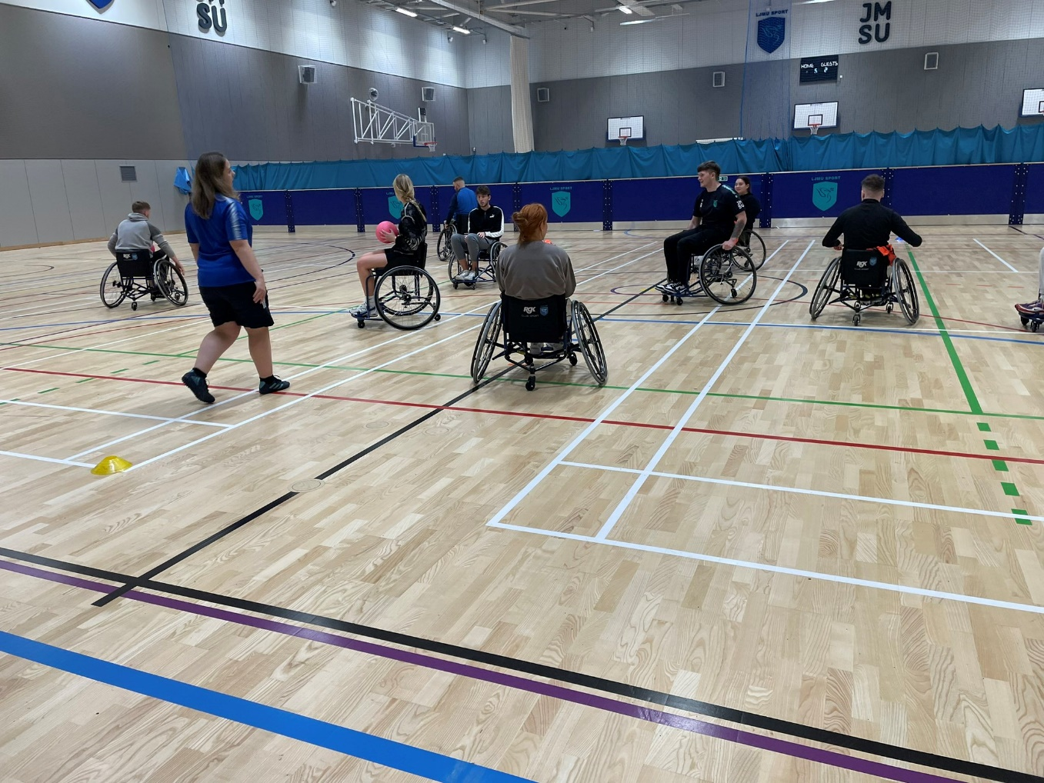
A photo of the session.

Slide 11
What does the literature say?

Slide 12
WHAT DOES THE LITERATURE SAY ABOUT DISABILITY SPORT?
McConkey (2021) says that including people with disabilities can be tough for both the athlete and the coach due to all the planning which needs to take place prior to the session itself. Coaching is a process and is much more than one session.
It has been previously said that the coaching role itself can be vital for people with disabilities if the stigma around disability sport is to be addressed. (Black,2011; Hassan and Lynch 2014 as cited in McConkey,2016)
Between 29-50% of disabled people are classed as overweight which brings extra barriers for people with disabilities in relation to accessing sport and physical activity. (Grandisson et al, 2012)
If interested:
Darcy, S., Lock.D., and Taylor, T. (2017) “Enabling Inclusive Sport Participation: Effects of Disability and Support Needs on Constraints to Participation” Leisure Sciences (39), p20-41.
French, D and Hainsworth, J (2001), “There aren’t any buses and the swimming pool is always cold!”. Managing Leisure, p35-49.
Grandisson, M., Tetreault, S. and Freeman, Andrew R. “Enabling Integration in Sports for Adolescents with Intellectual Disabilities”. Journal of Applied Research in Intellectual Disabilities. 25 (3), p217-230.
Kitchin, P. Peile, C and Lowther, J (2019). “Mobilizing capacity to achieve the mainstreaming of disability sport”. Managing Sport and Leisure 24 (6), p424-444.
McConkey, R., Pochstein, F., Carlin, L., Menke, S. (2021), Promoting the social inclusion of players with intellectual disabilities: an assessment tool for sports coaches.” Sport in Society, 24 (3) p430-439.”

Slide 13
How can we adapt OUR LECTURES/SESSIONS more as teachers/coaches?
Ensure that all presentations/lectures are easily accessible for those with disabilities (subtitles on videos, no colour clash etc, BSL Interpreter or 1-1 support if needed).
Ensure that if the activity we are delivering isn’t suitable, make some adaptations. For example if playing 2 touch football and someone has CP, say they can have 5 touches instead.
Educate our students/networks about disability and disability sport. If we don’t do this, it could go back to the 1980s (when disabled people were seen as a burden), this will make them aware and hopefully supportive of disability and disability sport.
Integrate a Disability Sport module onto the sports studies courses. This would make a huge difference. Focus on both grassroots and elite.
Take more of an interest in the students who have disabilities – a lot of them are able to do great things but don’t necessarily always get the support. (I was lucky to have the support of Alex and the other tutors, not many have that support)
Deliver MORE Disability Sport sessions – most sessions can easily be adapted, if a student with a disability isn’t engaging (could have ADHD or Autism etc, let them be the leader (within reason) and allow them to fulfil their potential!.

Slide 14
ANY QUESTIONS?

