Slide 1
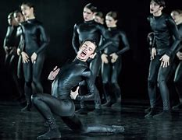
Dance Teach-Meet Terpsichore and pedagogy: Embedding subject specific educational theory in the dance studio
27/03/2023
(16.00-17.15)
Claire Coleman: Lecturer – UoB (PGCE FET)
Guest: Anita Wadsworth: Artist/Lecturer – Bird College (BA Hons) & bbodance - Dance Teaching Qualifications)
National Youth Dance Company / Sharon Eyal – Used To Be Blonde (2018)
Notes:
Contacts:
C.Coleman3@brighton.ac.uk
anitawadsworth@me.com

Slide 2
AIMS
Recognise and discuss some of the key challenges faced by dance teachers working in the Further Education sector today.
Explore resources and strategies to support these challenges in your future teaching practice.
Identify key academic sources and pedagogic resources that can support the development of your subject specialist knowledge.
Recognise how all areas of focus can support your achievement of the ETF Professional Standards for Teachers and Trainers 2022.

Slide 3
NATIONAL YOUTH DANCE COMPANY
NYDC Schools Workshops Trailer Captioned (vimeo.com)
Notes:
Watch: NYDC NYDC Schools Workshops Trailer Captioned (vimeo.com)
For further information on school and college workshops contact lucy@danceeducation.uk

Slide 4
LET'S START BY CELEBRATING THE VARIETY OF DANCE PROVISION IN THE UK FURTHER EDUCATION SECTOR TODAY!
BTEC/UAL Dance courses: Many FE colleges offer BTEC Dance courses at Level 2 and Level 3, which cover a range of topics such as dance technique, choreography, performance skills, and dance appreciation.
A-level Dance courses: Some FE colleges offer A-level Dance courses, which provide a more academic approach to the study of dance and cover areas such as dance history, critical analysis, and performance skills.
Access to Higher Education (Dance): Some FE colleges offer Access to Higher Education courses in Dance, which are designed to provide a pathway to higher education for mature learners who may not have traditional qualifications.
Foundation degrees and Higher National Diplomas (HNDs): Some FE colleges offer Foundation degrees and HNDs in Dance, which provide a more vocational approach to the study of dance and may include opportunities for work placements and industry experience.
Community dance provision: Some FE colleges offer community dance provision, which provides opportunities for people of all ages and abilities to participate in dance classes and workshops.
Notes:
Gold Arts Award

Slide 5
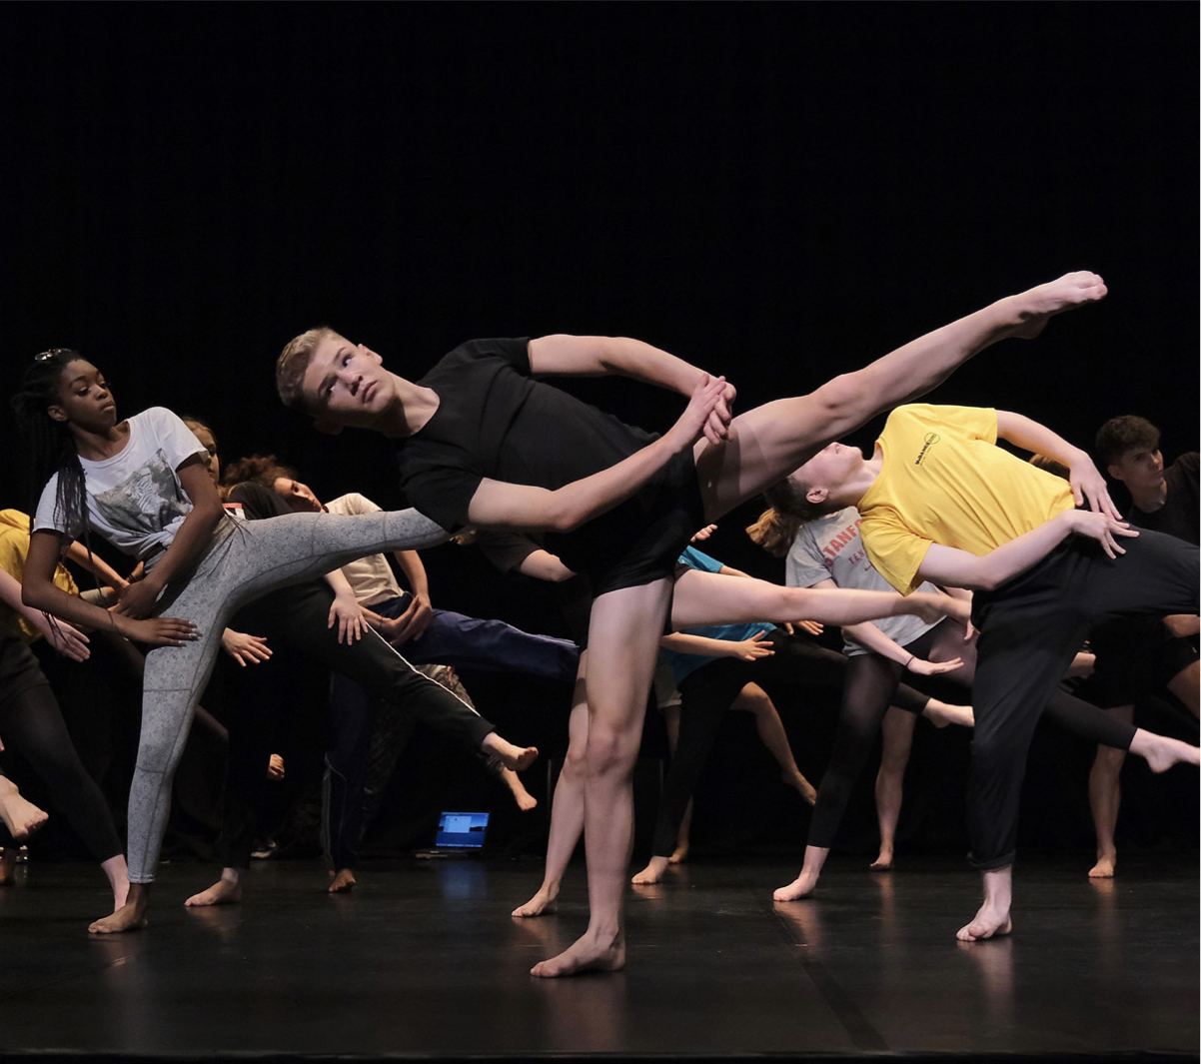
WHAT ARE THE CHALLENGES FACED BY DANCE TEACHERS IN THE FE DANCE SECTOR TODAY AND HOW CAN WE ADDRESS THESE IN OUR PRACTICE?
IMAGE CREDIT: Brian Slater Photograph
Everything We Loved About Dance Was Taken (OneDanceUK 2018)
Notes:
Everything-We-Loved-About-Dance-Was-Taken-2.pdf (onedanceuk.org)

Slide 6
"Dance teachers in FE face a range of challenges, including limited resources, high workload demands, and a lack of recognition for their work, as well as the need to adapt to changes in the curriculum and to respond to the diverse needs of their students.”
"Opportunities for dance teachers in FE include the potential to develop partnerships with industry professionals, to use digital technologies to enhance learning, and to promote cross-disciplinary collaboration within the institution and beyond.”
(Hall & Casey, 2018)

Slide 7
RECRUITMENT AND RETENTION
The decline in dance in schools and colleges is due to external pressures, not a lack of engagement.
49% of educators cited external pressure for students to take ‘academic subjects’ as the key reason for the ongoing decline of dance in schools.
Other integral factors included school leaders wanting students to take EBacc subjects (46%) and pressure from parents/carers to take other subjects (46%).
Almost two thirds of dance educators (61%) report they have noticed a decline in the uptake of dance qualifications during this time. A child’s opportunity to study dance is heavily dependent on where they study. (OneDanceUK, 2018)
In an environment where vocational education is increasingly prioritised over the arts, dance can struggle to be seen as a viable career path, resulting in limited student numbers and reduced funding for provision. (Phillips, 2018)
Winter (2019), also argues that there is still a perception that dance is not a viable career path, which may discourage state school students from pursuing it. She argues that there is still a belief that dance is still seen as a hobby or pastime rather than a serious profession.

Slide 8
HOW CAN WE PROMOTE THE VALUE OF DANCE EDUCATION IN THE FE SECTOR?
Recent years have shown a severe decline in the uptake of two dance-based qualifications (GCSE & A level dance). There has, however, been a steady increase in uptake of vocational qualifications at Levels 1, 2 and 3, indicating that some schools and students are simply changing qualification rather than not studying dance at all.
“Too many parents/schools/colleges regard [Dance] as a non-academic subject (at GCSE and A Level) and therefore the challenge is getting them to change their mindset, and to show them that studying Dance in an educational setting is more beneficial to their child’s future career than they think. Not everyone who studies Dance wants to be a professional dancer!”
(OneDanceUK, 2018)

Slide 9
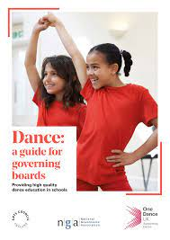
HOW CAN WE PROMOTE THE VALUE OF DANCE EDCUATION IN THE FE SECTOR?
Share your students amazing work and talent with your community!
Dance: A guide for governing board. Providing high quality dance education in schools (Arts Council England, 2021)
https://www.artscouncil.org.uk/sites/default/files/download-file/Governor%20Guides%20-%20Dance.pdf
Notes:
Discuss performance opportunities. Sharing Dance: a guide for governing boards with your local schools and colleges
PS 20. Develop enrichment and progression opportunities for learners through collaboration with employers, higher education and/or community groups.

Slide 10
INDUSTRY RELEVANCE
There is a need to ensure that further education dance teaching remains relevant to the needs of the dance industry. This may involve greater collaboration with industry professionals, the development of relevant curricula, and the provision of opportunities for students to gain practical experience.
“I think there is a lot of miseducation/understanding about the value of dance and the arts, how academic the courses actually are, and the plethora of arts-based careers that are available in the industry and in academia.”
(OneDanceUK, 2018)

Slide 11
INDUSTRY RELEVANCE
Price and Coaten (2019) suggest, “The involvement of industry professionals is essential in ensuring that students are prepared for the realities of working in the dance industry and that the curriculum is relevant to current industry practices and trends.”
and
"Providing opportunities for students to engage with the wider dance community, through performances, workshops, and other events, not only enhances their learning experience but also helps to build their professional networks and prepares them for future careers in the dance industry."

Slide 12
RESOURCES TO SUPPORT LINKS TO INDUSTRY
https://www.onedanceuk.org OneDanceUK. Dance Ambassadors, Young Creatives, Dance Teacher Advocacy Group
https://www.sadlerswells.com/take-part/schools-and-colleges/ Sadlers Wells Schools and colleges play a pivotal role in connecting students to cultural experiences. We have a range of programmes that aim to help students connect with the world of dance.
https://nydc.org.uk National Youth Dance Company (NYDC) aims to create and perform innovative and influential dance, bringing together some of the brightest dance talent from across England to work with Sadler’s Wells’ internationally renowned Associate Artists and visiting companies.
https://www.roh.org.uk/learning ROH Chance to Dance, Young Creatives, School matinee performances
https://danceinteractive.jacobspillow.org Jacobs Pillow An ever-growing collection of dance videos filmed at Jacob’s Pillow from the 1930s to today, plus multi-media essays and a related podcast.
Young People Dance - English National Ballet English National Ballet
Image: ENB: Young People Dance Programme
Notes:
Discuss the education outreach programmes that each company offers
PS
8. Develop and update knowledge of your subject specialism, taking account of new practices, research and/ or industry requirements.
20. Develop enrichment and progression opportunities for learners through collaboration with employers, higher education and/or community groups.

Slide 13
DIVERSITY AND INCLUSION
There is a growing concern about the lack of diversity and inclusion in the dance sector, including further education. This issue encompasses issues of representation, access, and equity, and there is a need for greater efforts to be made to address these issues.
The lack of diversity in dance education is a pressing issue, with the majority of students and teachers coming from white, middle-class backgrounds. This can create barriers to entry for students from diverse cultural and socio-economic backgrounds. (Phillips, 2018)
Winter (2019) suggests that socio-economic factors may also contribute to the underrepresentation of state school students in dance education stating that, the students who have the time, money and energy to pursue extra-curricular dance activities outside of school are more likely to be from privileged backgrounds.
Cownie (2016) emphasizes the importance of exposing students to a variety of dance styles and cultures and encourages educators to explore ways to make dance accessible to all students, regardless of their background or ability level.

Slide 14
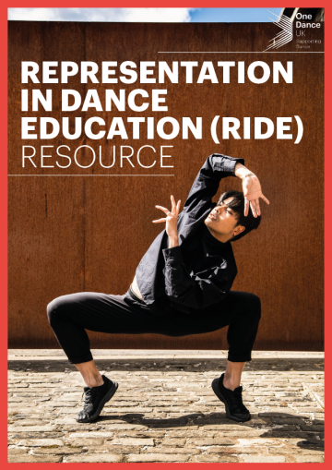
RIDE (Representation in Dance Education) resource is a new free resource for teachers created by our Decolonising the Dance Curriculum roundtable.
The aim of RIDE is to support teachers and educators to deliver content that is authentic, diverse and inclusive. Teachers will also be able to find global majority artists and companies local to them to support the delivery of dance in their school.
Notes:
RIDE-5.pdf (onedanceuk.org)

Slide 15
HAVE YOU IDENTIFIED ANY BARRIERS TO DIVERSITY AND INCLUSION IN YOUR PLACEMENT/CURRICULUM? HOW CAN WE ADDRESS THESE?
Notes:
PS
5. Value and champion diversity, equality of opportunity, inclusion and social equity.
15. Plan and deliver learning programmes that are safe, inclusive, stretching and relevant to learners’ needs.
2. Promote and embed education for sustainable development (ESD) across learning and working practices.

Slide 16
CURRICULUM DESIGN AND ASSESSMENT
The pressure to conform to traditional assessment methods, such as exams and written assignments, can be challenging for dance students, who often excel in practical and creative assessments.
"The challenge is to ensure that dance education in FE remains responsive to the needs of learners and that it continues to innovate and evolve."
"There is an opportunity to develop more flexible and inclusive models of provision, which take account of the changing needs and aspirations of learners and the demands of the dance profession.”
(Phillips, 2018)

Slide 17
CURRICULUM DESIGN AND ASSESSMENT (Subject specific pedagogic approaches)
High-quality dance provision may be achieved through investing in high quality CPD, sharing good practice, creating new schemes and units of work, working with local dance artists and dance companies.
(OneDanceUK, 2018)
Price and Coaten (2019) suggest, "The use of diverse teaching methods, such as problem-based learning and experiential learning, allows students to develop a range of skills and knowledge that can be applied to a variety of contexts within the dance industry.”
And
“student-centered and inclusive, with an emphasis on collaboration and the development of creativity and self-expression.”
Phillips (2018) notes that, "FE institutions can be at the forefront of developing new and innovative approaches to dance education, and in creating pathways for progression to higher education and the wider dance industry.”

Slide 18
ACADEMIC READINGS TO SUPPORT DANCE PEDGAGOGY
Gray, J.R., 2015. Dance Teaching and Learning: Shaping Practice. 3rd ed. Champaign, IL: Human Kinetics.
Guarino, L. & Oliver, W. (2014). Jazz Dance: A History of the Roots and Branches. Gainesville, FL: University Press of Florida.
Guthrie, J. & Weber, R. (Eds.) (2019). Dance Education in Practice: Teaching, Choreography, and Research. New York: Oxford University Press.
Koff, S. R. (2021). Dance Education: A Redefinition. New York, NY: Routledge.
Mainwaring, L, Pysch, C and Krasnow, D (2010). Teaching the Dance Class: Strategies to Enhance Skill Acquisition, Mastery and Positive Self-Image. Journal of Dance Education, 10 (1), Available at: http://www.citraining.com/Teaching-the- Dance-Class-Strategies.html [Accessed 21st September 2021]
North, A., & Guthrie, J. (2017). Inclusive Practice in Dance in Further Education. Research in Dance Education, 18(2), 164-173.
Sööt, A and Viskus, E (2014). Contemporary Approaches to Dance Pedagogy – The Challenges of the 21st Century, Procedia - Social and Behavioral Sciences, 112, p. 290-299, Available at: https://doi.org/10.1016/j.sbspro.2014.01.1167 [Accessed 21st September 2021]

Slide 19
PRACTICAL GUIDES TO TEACHING A LEVEL AND BTEC DANCE
"A Level Dance: An Essential Guide for Teachers" by Linda Jasper and Karen Berry (2016). This guide provides an overview of the A Level Dance syllabus, including curriculum design, assessment, and practical teaching strategies.
"Teaching A Level Dance: A Practical Guide" by Diane van Schoor and Rebecca Webber (2018). This guide offers practical advice on teaching A Level Dance, including developing critical thinking skills, incorporating technology into the classroom, and preparing students for assessments.
"Planning to Teach A Level Dance" by Chris Wardle (2020). This guide focuses on planning and delivering effective lessons for A Level Dance, including structuring lessons, developing learning objectives, and using assessment to inform teaching practice.
"The A Level Dance Toolkit" by Michaela Reedy and Rebecca Weber (2019). This guide provides practical resources for teaching A Level Dance, including lesson plans, assessment templates, and advice on engaging students with the subject matter.
"Teaching and Learning Dance: A Guide for A Level Students and Teachers" by Laura Purkiss (2021). This guide is aimed at both students and teachers and offers practical advice on developing technique, choreography skills, and critical analysis in A Level Dance.
"BTEC Dance Level 3: A Guide to Teaching and Assessing" by Rachel Wyatt and Emily Spruce (2018). This guide offers practical advice on teaching and assessing the BTEC Dance Level 3 qualification, including curriculum design, assessment strategies, and preparing students for exams.
"Teaching BTEC Dance: A Practical Guide" by Claire Sparrowhawk (2018). This guide offers practical advice on teaching BTEC Dance, including curriculum design, assessment strategies, and engaging students with the subject matter.

Slide 20
RESOURCES TO SUPPORT CHOREOGRAPHIC PRACTICE
Choreography: Creating and Developing Dance for Performance : Flatt, Kate: Amazon.co.uk: Books
Dance Improvisations: Amazon.co.uk: Justine Diane Reeve: 9781450402149: Books
https://www.youtube.com/watch?v=Vx0fe9R1D7E William Forsythe, Improvisation Technologies
https://waynemcgregor.com/learning/resources/ MIND AND MOVEMENT.
https://www.youtube.com/watch?v=gUqZPfGIX6U Frantic Assembly Masterclass: Building Blocks for Devising
https://www.youtube.com/watch?v=4aeBhLakp3c&list=RDCMUCFnPErueKJVoIYwZYFfDyUQ&index=4 Planet Dance: The Place
Notes:
PS
8. Develop and update knowledge of your subject specialism, taking account of new practices, research and/ or industry requirements.
9. Share and update knowledge of effective practice with colleagues, networks and/or research communities to support improvement.
10. Critically review and apply your knowledge of educational research, pedagogy, and assessment to develop evidence-informed practice.

Slide 21
TECHNOLOGICAL ADVANCEMENTS
With the increasing role of technology in society, there is a need to incorporate technology into dance teaching in a meaningful way. This may involve the use of digital resources, virtual learning environments, and online delivery methods.

Slide 22
EMBEDDING DIGITAL TECHNOLOGY IN DANCE TEACHING
Lefèvre and Crawley (2019) suggest,
Video and audio recording: These technologies can be used to capture and review student performances, provide feedback, and support self-reflection.
Social media platforms: Social media can be used to share dance resources, connect students with the wider dance community, and provide opportunities for peer feedback.
Online learning platforms: These can be used to deliver course materials, resources and assessments.
Mobile apps: Apps such as those for music production, choreography, and fitness can provide new tools for students to create, explore and develop their dance practice.

Slide 23
RESOURCES TO SUPPORT THE EMBEDING OF TECHNOLOGY IN DANCE TEACHING
Apple IOS | Choreograhpy | Choreomaker | Choreo | Choreo Creator
William Forsythe, Improvisation Technologies - YouTube
OnForm: Video Analysis App on the App Store (apple.com)
Bloom by Brian Eno and Peter Chilvers | GenerativeMusic.com
Dashboard | Padlet
Dashboard | Piktochart
Image: OnForm: Video Analysis App
Notes:
PS 16. Select and use digital technologies safely and effectively to promote learning.

Slide 24
DECLINE IN PHYSICAL AND MENTAL WELLBEING
SINCE THE START OF THE COVID 19 PANDEMIC, THERE HAS BEEN A SIGNIFICANT DECLINE IN PHYSICAL AND MENTAL WELLBEING FOR BOTH STAFF AND STUDENTS. (OneDanceUk, 2018)
MENTAL WELLBEING
81% of educators reported their student’s mental wellbeing had declined.
63% of educators state their own mental wellbeing had declined.
PHYSICAL HEALTH
Students appear to be less fit physically since the start of the COVID-19 pandemic, with 79% of educators stating their students’ physical fitness has declined.
Educators reporting on their own physical health gave a mixed picture, however over half (56%) reported a decline in physical fitness compared to 25% reporting an improvement.
“Once we returned...not only do they have work to complete but their current ability is worse than when they ended Year 10 – so they all feel they have got worse and are now being assessed.”
“Student wellbeing and mental health has been a huge issue with regards to managing my job since the pandemic. This was already an issue but has increased significantly.”

Slide 25
EMERGING FROM THE PANDEMIC
Even as we emerge from the pandemic, less children are being offered dance as an extra-curricular activity.
The long-term impact of the pandemic on the freelance dance workforce is evident, as the number of educators engaging with no visiting artists has doubled from 16% pre-pandemic to 30% for September 2021.
“We lost all the value and importance of enrichment activities such as working with professional artists, seeing live performances and losing opportunities to perform.”
(OneDanceUk, 2018)

Slide 26
STUDYING DANCE IS PROVEN TO HAVE A POSITIVE IMPACT ON YOUNG PEOPLES PHYSICAL AND MENTAL HEALTH
The very act of making art (visual or performance) develops a young person’s sense of identity and self-efficacy and increases resilience, all key components of good mental health.
Participating in cultural or creative activities means you are more likely to report good health. 62% of participants who engaged in dance for this study were more likely to report good health.
Feelings of depression have been found to reduce for participants who engage in dance-based intervention.
Dance can make a positive impact on health, wellbeing and future aspirations.

Slide 27
STRATEGIES AND RESOURCES TO SUPPORT DANCE STUDENTS AND TEACHERS' WELLBEING
Creating a safe and nurturing dance studio
Start with a detailed dance specific questionnaire (go beyond the information provided by the college)
Undo traditions in dance teaching – favoritism, technique, competition
Make the dance studio a safe space. undoing the dance school culture. Actively work to rebalance equality in your dancers training
Collaborative work – everyone's ideas are valued
Safe Touch
People Dancing :: Hands on... Hands off :: Foundation for Community Dance
Dancers Wellbeing
Dancers' education, healthcare and research, NIDMS, United Kingdom
Home | Equoo for Education (equoo-wellbeing.com)
Teachers Wellbeing
Mindful Teachers
Education Support helpline - free and confidential emotional support for teachers and education staff
naht-coronavirus-wellbeing-proof-4-1.pdf (annafreud.org)
Notes:
PS
6. Develop collaborative and respectful relationships with learners, colleagues and external stakeholders.
13. Promote and support positive learner behaviour, attitudes and wellbeing.

Slide 28
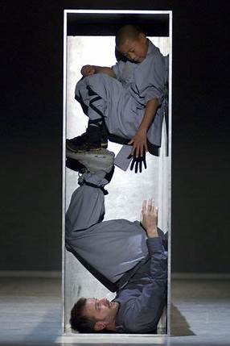
SPACE FOR QUESTIONS AND THOUGHTS
Image: Sutra (2008) Sidi Larbi Cherkaoui

Slide 29
ACADEMIC REFERENCES
Cownie, F. (2016). The value of dance in education. Education 3-13, 44(3), 243-255.
Hall, C. & Casey, K. (2018). Dance in the Further Education Curriculum: Context, Challenges and Opportunities. Dance Research, 36(2), 247-259.
Lefèvre, C.M. & Crawley, M.-L. (2019). Integrating Digital Technologies into Dance Teaching in Further Education. Research in Dance Education, 20(1), 55-70.
Linsell, H. (2021). Dance and Covid-19: A view from further education. Research in Dance Education, 22(1), 4-15.
North, A. & Guthrie, J. (2017). Inclusive Practice in Dance in Further Education. Research in Dance Education, 18(2), 157-169.
Phillips, M. (2018). The future of dance in further education. Research in Dance Education, 19(3), 254-259.
Price, M. & Coaten, R. (2019). Dance Education in Further Education: A Case Study of Teaching and Learning Practice. Research in Dance Education, 20(3), 306-322.
Winter, A. (2019). Why are so few dance students from state schools? The Guardian. Retrieved from https://www.theguardian.com/education/2019/sep/10/why-are-so-few-dance-students-from-state-schools

