Slide 1
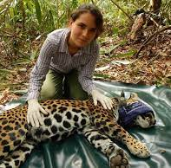
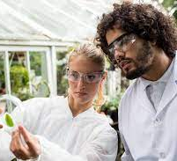
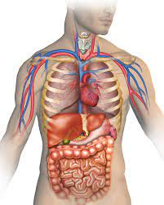
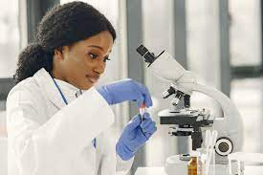
Back to basics in the teaching of biology
Nicola Drew BSc(Hons) MA (Hons) PGCE, Lecturer in biology and animal management, Wakefield college, West Yorkshire

Slide 2
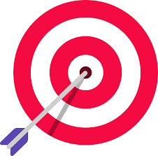
Session aim
To influence you to include those basic skills of maths, English and digital literacy in your biology teaching!

Slide 3
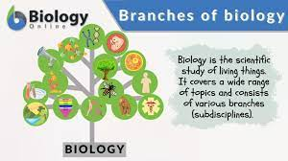
Why teach (and why study) biology?
As biological organisms ourselves, we rely on biological processes to survive. The science of biology is THE science of life.
Furthermore, as we come out of a global viral pandemic, and with future challenges of climate change, ecosystem conservation and food production for an increasing global population, biological knowledge and research will play an increasingly important role in sustaining life on our planet.

Slide 4
Foundational premise
Biology, like other sciences, relies on the scaffolding of knowledge from simple to more complicated concepts.
However, during my teaching I have noticed that many students were struggling with the fundamental skills of mathematics and English, and that digital skills were under-utilised in the science classroom.
How can we address this?

Slide 5
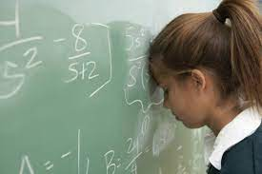
Maths for biology
According to the UK awarding body, the OCR (Oxford, Cambridge and RSA), “mathematical literacy is a vital attribute for modern biologists” (OCR, 2022).
Students who engage in further education with a sound mathematical background are more likely to become more competent scientists and have a wider range of transferable skills (ibid, 2022).

Slide 6
Maths for biology

Slide 7
Time to self-reflect! Maths skills for biology
Do the students in your classes possess a good level of mathematical knowledge? Are they regularly given the opportunity to practice mathematical thinking? Is mathematics embedded in your teaching? What challenges do you think you might face trying to do this?

Slide 8
English for biology
If learning involves the construction of mental ‘schema’ or units of knowledge, a spiral curriculum involves the acquisition of basic knowledge which acts as a foundation for the subsequent addition of more complex ideas and terms (Bruner, 2006).
In the same way, allowing students to understand the origins of words used to explain biological phenomena can support their understanding of related terms and concepts, and provide basic underpinning comprehension for more complicated biological ideas.
Let's look at a few examples.

Slide 9
Examples
erythrocyte (erythr- red, cyte – cell – Latin) - link to other words e.g. cytology, leukocyte, erythropoietin
Pathogenesis (Path- meaning disease, genesis – meaning the creation or making of something - Greek) - link to other words such as pathology, genetics

Slide 10
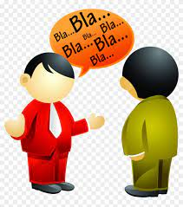
English for biology – top tip!
Think of biology as a foreign language! By breaking down the parts of the word (prefix, suffix etc) this will help students to scaffold knowledge across to other terms in biology, and in fact other disciplines, for example English Literature.

Slide 11
Time to self-reflect! English skills for biology
Do you write biological terms on the whiteboard and explain how the word is made up? Can you see a potential for breaking the word down, and explaining its origins? How will this help your students further develop their biological language skills?

Slide 12
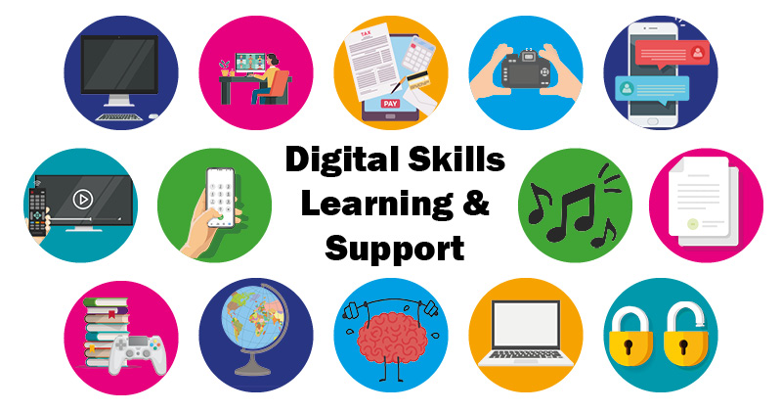
Digital skills – pedagogical intervention
The teaching of the structure and function of living organisms forms the basis of much of the syllabi of the life sciences in both school and post-compulsory educational contexts (Balcombe, 2001).
Despite this, many current students of biology have difficulties with understanding the place and relationship of various anatomical landmarks within a living organism, and it has been suggested that the standard use of two-dimensional diagrams to illustrate what are essentially three-dimensional concepts can impede some students acquisition of basic scientific knowledge and principles (Yammime and Violato, 2014).
Furthermore, growing ethical and religious objections to the use of either live animals or recently killed animal body parts poses a challenge to educators to ensure the inclusion of all learners who wish to study a biological subject (Balcombe, 2001; Goodyear, 2002).

Slide 13
https://academy.allaboutbirds.org/features/birdanatomy/

Slide 14
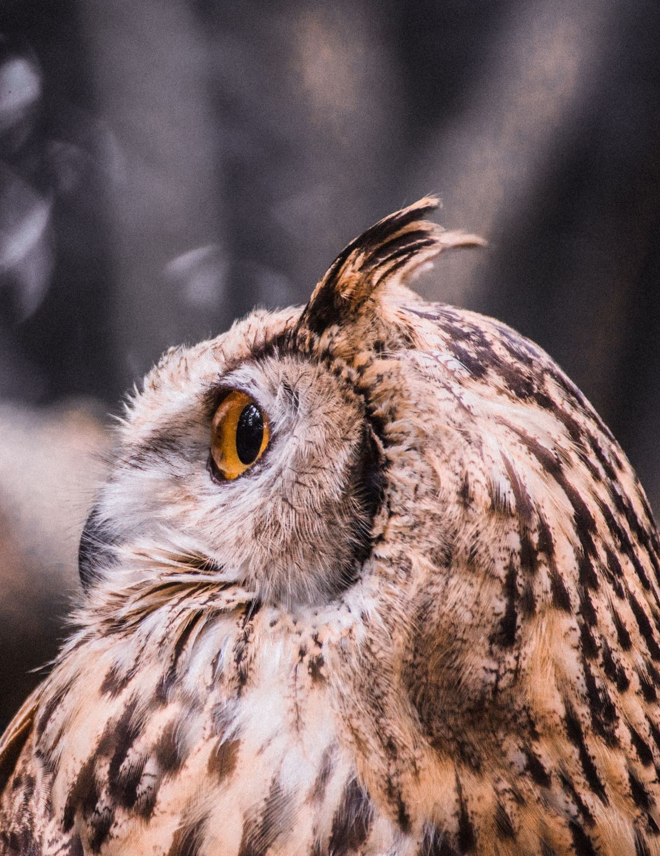
Time to self-reflect!
Do you incorporate digital tools in the teaching of biology? Could you make more use of online resources such as the Bird anatomy resource just cited?

Slide 15
Critical literacy
The notion of critical literacy in relation to pedagogical activities has its roots in the work of the Brazilian theorist Paulo Freire (1970).
Defined, critical literacy can be understood as the questioning and examining of ideas.
On first reflection, the incorporation of a critical literacy approach into a scientific curriculum may seem unimportant to the acquisition and understanding of scientific terminology and concepts.
However, research has suggested that using critical theory in the teaching of biology can enhance the biological literacy and knowledge of students (Daly-Lasch, 2019; Suwoni et al, 2017).

Slide 17
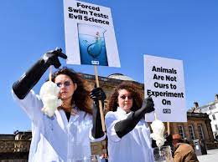
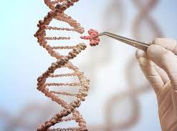
Using critical literacy in the teaching of biology – some practical examples
The subject of biology is a fertile ground for this approach.
Many areas that could be subject to critical appraisal, for example:
stem cell technology
genetic engineering
animal experimentation.

Slide 18
Time to self-reflect! Critical literacy.
Where could you incorporate critical literacy in the classroom? How would you approach this?

Slide 19
SET Professional Standards
1. Critically reflect on and evaluate your practices, values, and beliefs to improve learner outcomes.
8. Develop and update knowledge of your subject specialism, taking account of new practices, research and/ or industry requirements.
10. Share and update knowledge of effective practice with colleagues, networks and/or research communities to support improvement.
17. Develop learners’ mathematics, English, digital and wider employability skills.

Slide 20
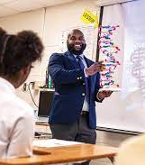
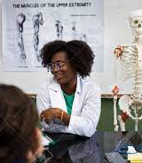
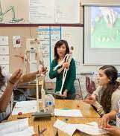
Thank you!
z
Any questions, please get in touch: n.drew@wakefield.ac.uk

Slide 21
References
Balcombe, J. (2001). Dissection: the scientific case for alternatives. Journal of Applied Animal Welfare Science, 4(2), 117-126. https://www.wellbeingintlstudiesrepository.org/acwp_arte/22/
Bruner, J. S. (2006). In search of pedagogy volume 1: The selected works of Jerome S. Bruner. Routledge.
Daly-Lesch, A. (2019). Using literacy to enact critical pedagogy and scientific inquiry: An analytic literature review. Texas Education Review, 7(2), 45-49. https://doi.org/http://dx.doi.org/10.26153/tsw/2284
Freire, P. (1970). The adult literacy process as cultural action for freedom. Harvard educational Review, 40, 205-212.
Goodyear, N. (2002). The use of animals in higher education: problems, alternatives and recommendations. Science Education, 86(6), 861-863. https://doi.org/https://doi.org/10.1002/sce.10062
OCR. (2022). Maths for Biology. https://www.ocr.org.uk/subjects/science/maths-for-biology/
Suwono, H., Pratiwi, H. E., & Susilo, H. (2017). Enhancement of student's biological literacy and critical thinking of biology through socio-biological case-based learning. Jurnal Pendidikan IPA Indonesia, 6(2), 213-222. https://doi.org/https://www.researchgate.net/deref/http%3A%2F%2Fdx.doi.org%2F10.15294%2Fjpii.v6i2.9622
Yammime, K. & Violato, C. (2014). A Meta-Analysis of the Educational Effectiveness of Three-Dimensional Visualization Technologies in Teaching Anatomy. Anatomical Sciences Education December 2014. 1-14.

